Slide 1
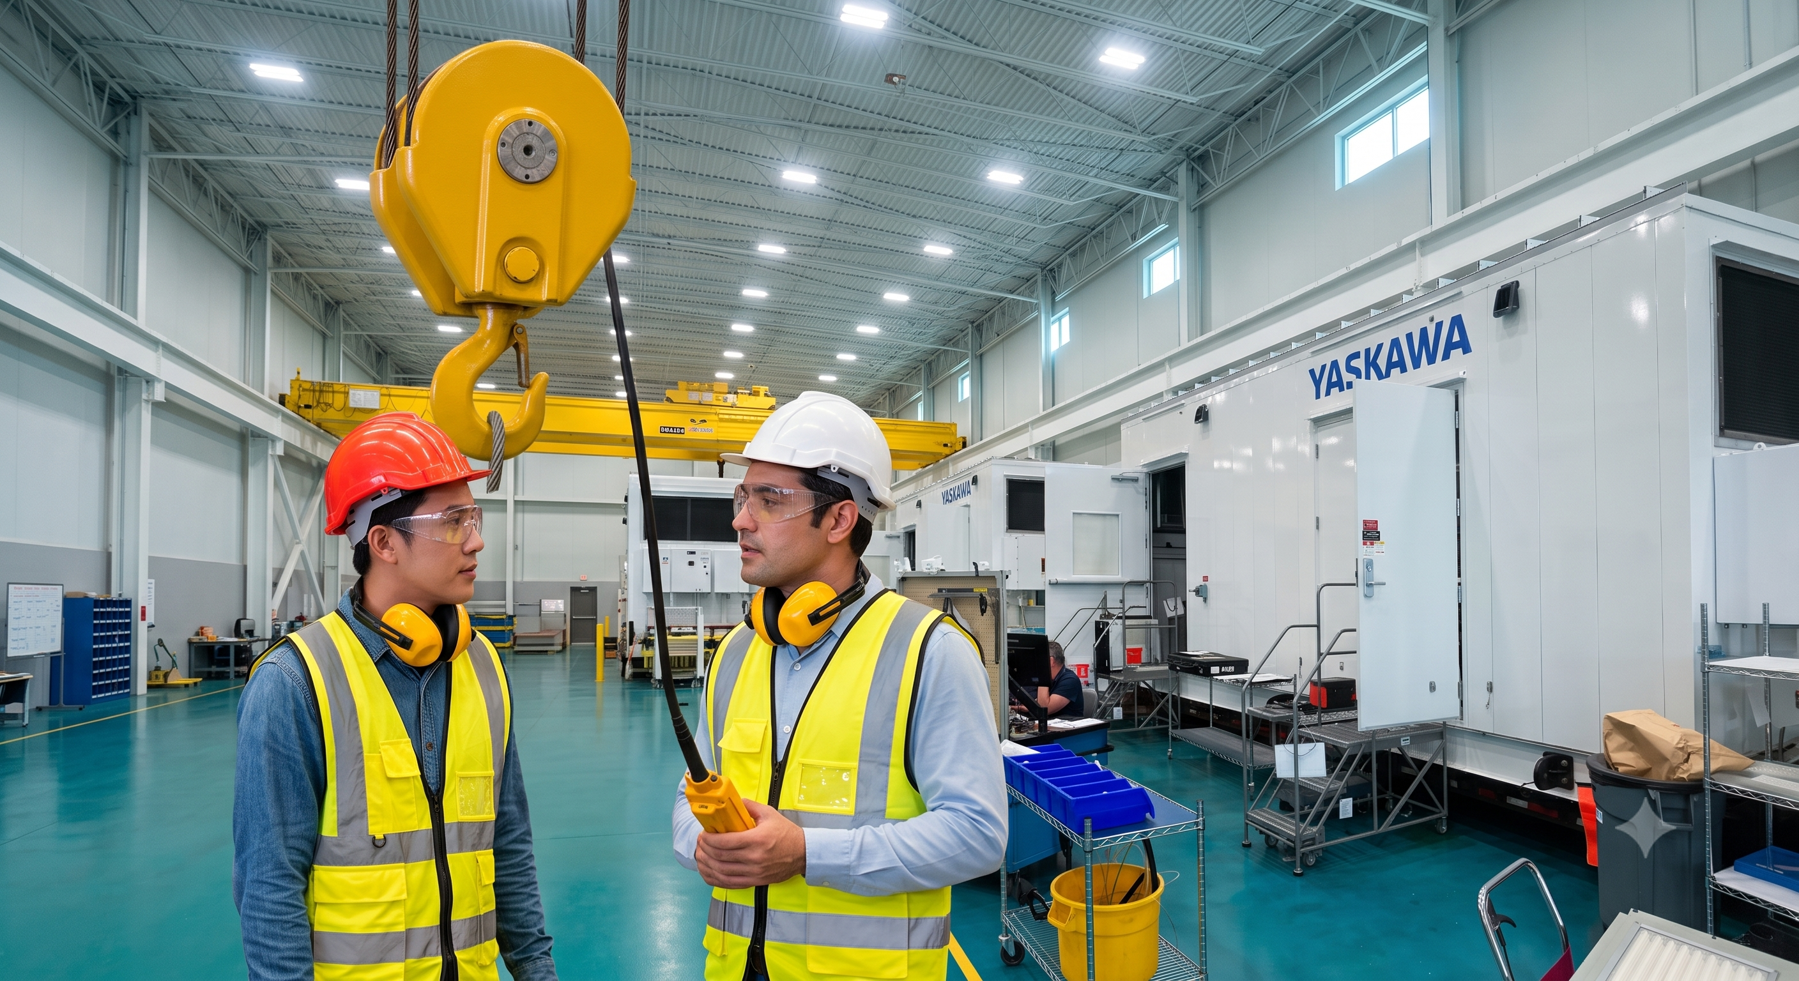
Overhead Crane Train-the-Trainer

Slide 2
Course Outline
Module 1: Foundations of Instructional Delivery
Module 2: Core Curriculum Mastery
Module 3: Micro Teaching Assignments
Module 4: Evaluation and Coaching Methods
Module 5: Practical Hands-On Evaluations
Module 6: Administration and Compliance
This is not a Crane and Hoist Operator class.
You must be a qualified operator for the type(s) of cranes you are teaching people to operate.

Slide 3
Module 1: Foundations of Instructional Delivery (Adult Learning)

Slide 4
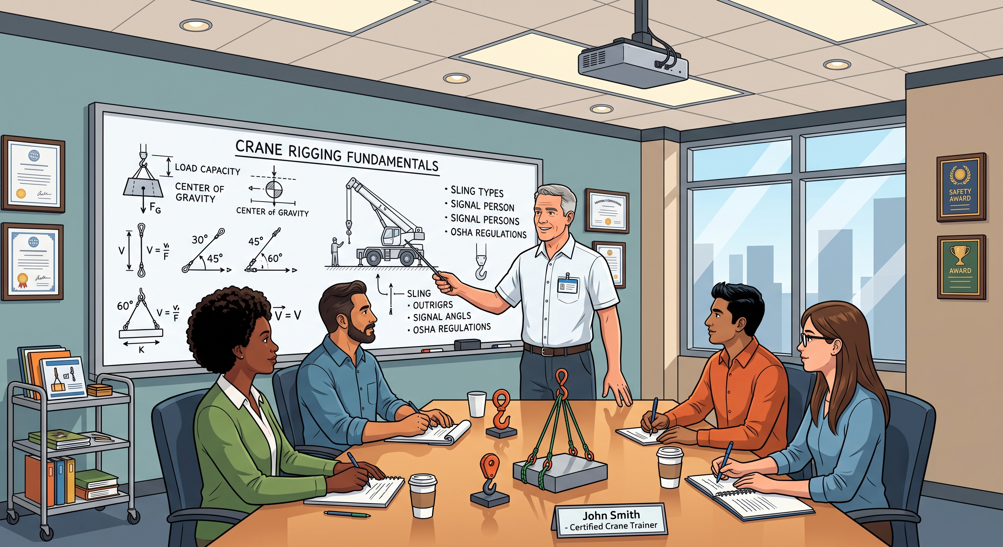
Module 1: Foundations of Instructional Delivery
Shifting from Operator to Trainer
Your job is no longer moving the load safely –
It’s ensuring the trainee is competent to do the same.

Slide 5
Module 1: Foundations of Instructional Delivery
Key Responsibility | Operator | Trainer
Safety & Compliance | Compliance for self and lift team, ensuring lift plan is flawless and the immediate path is clear | Focuses on compliance for others – identifying, correcting, and explaining why a trainee’s rigging or route path may be incorrect
Equipment Knowledge | Focuses on tacit execution – relying on lift plan/work instruction, muscle memory, personal experience, control of load using pendant or belly-box remote | Focuses on explicit delivery – breaking down complex physics, rigging angles, and maneuvers into clear, step-by-step instructions
Risk Mitigation | Active intervention – physically controlling the crane and hoist to avoid a hazard | Cooperative Oversight – allowing a trainee room to learn while knowing exactly when to step in before a mistake becomes a hazard
Communication | Operational directives – communicating directly with spotters and floor personnel to safely move the load | Used Adult Learning Theory to adapt to how different trainees process information (visual, verbal, hands-on)
Evaluation | Focuses on equipment readiness – verifying the crane, hoist, and rigging are safe to operate before starting production | Competency Verification – assessing if a trainee has truly mastered a skill or requires remediation before being signed off

Slide 6
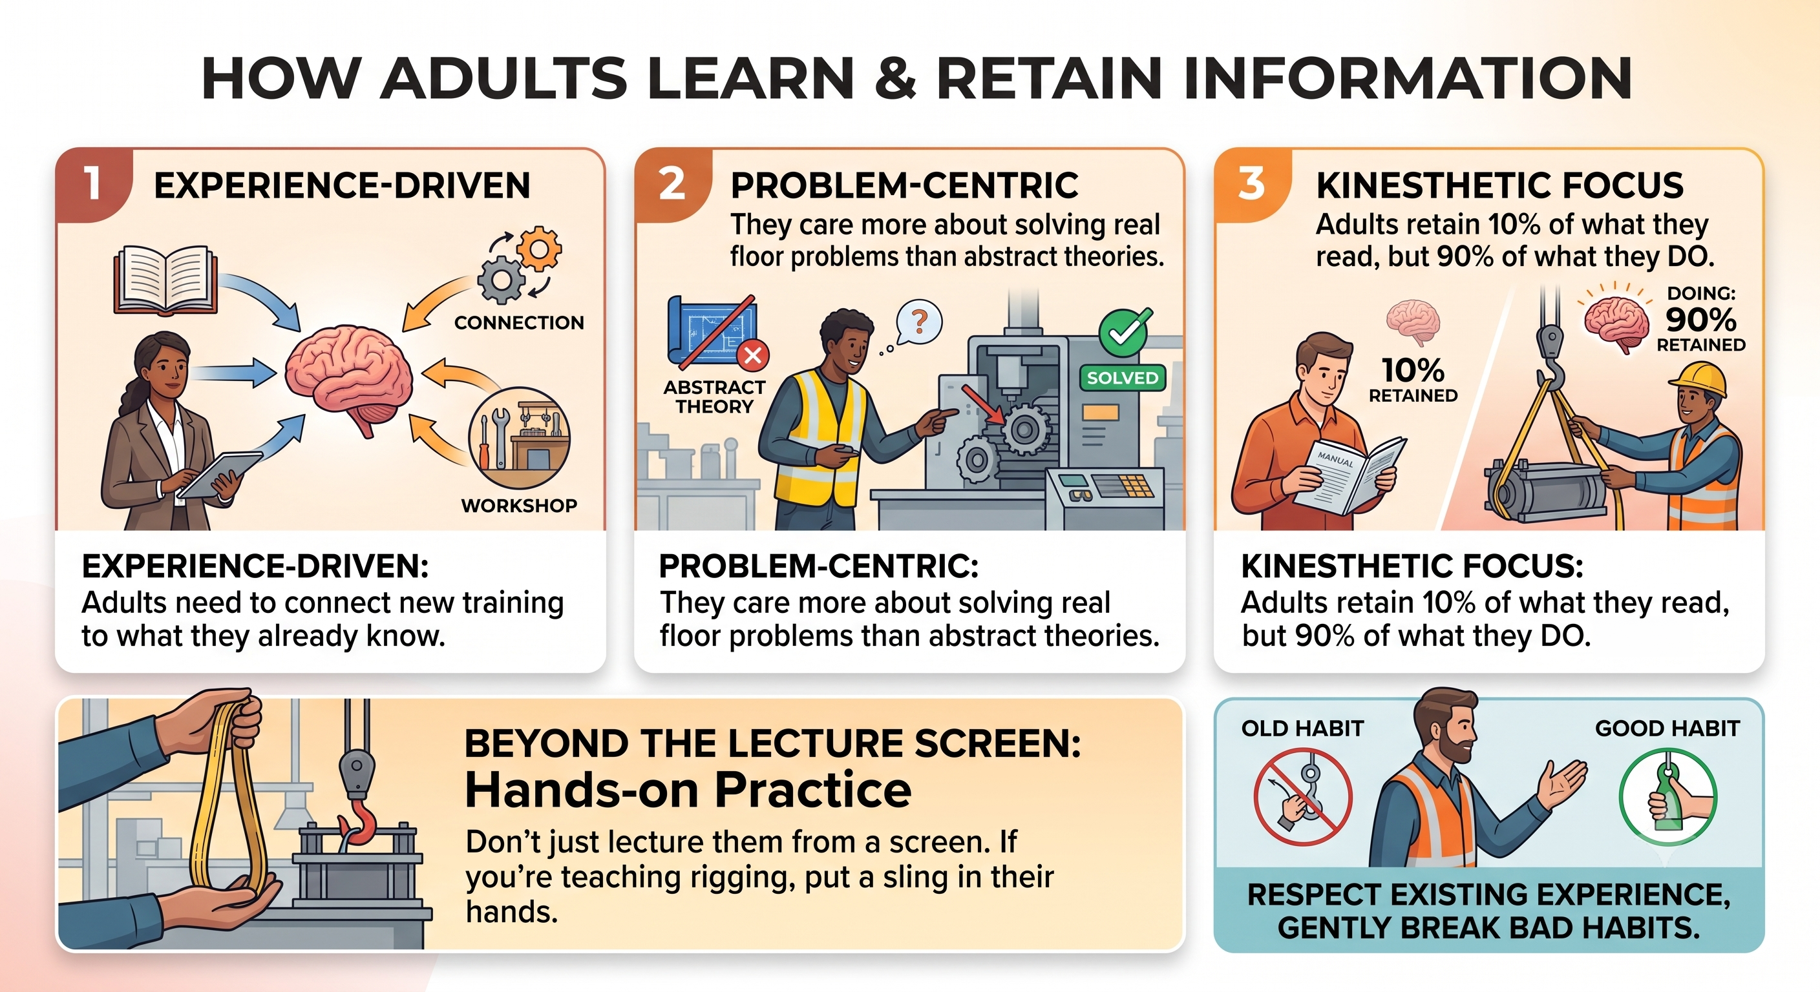
Module 1: Foundations of Instructional Delivery

Slide 7
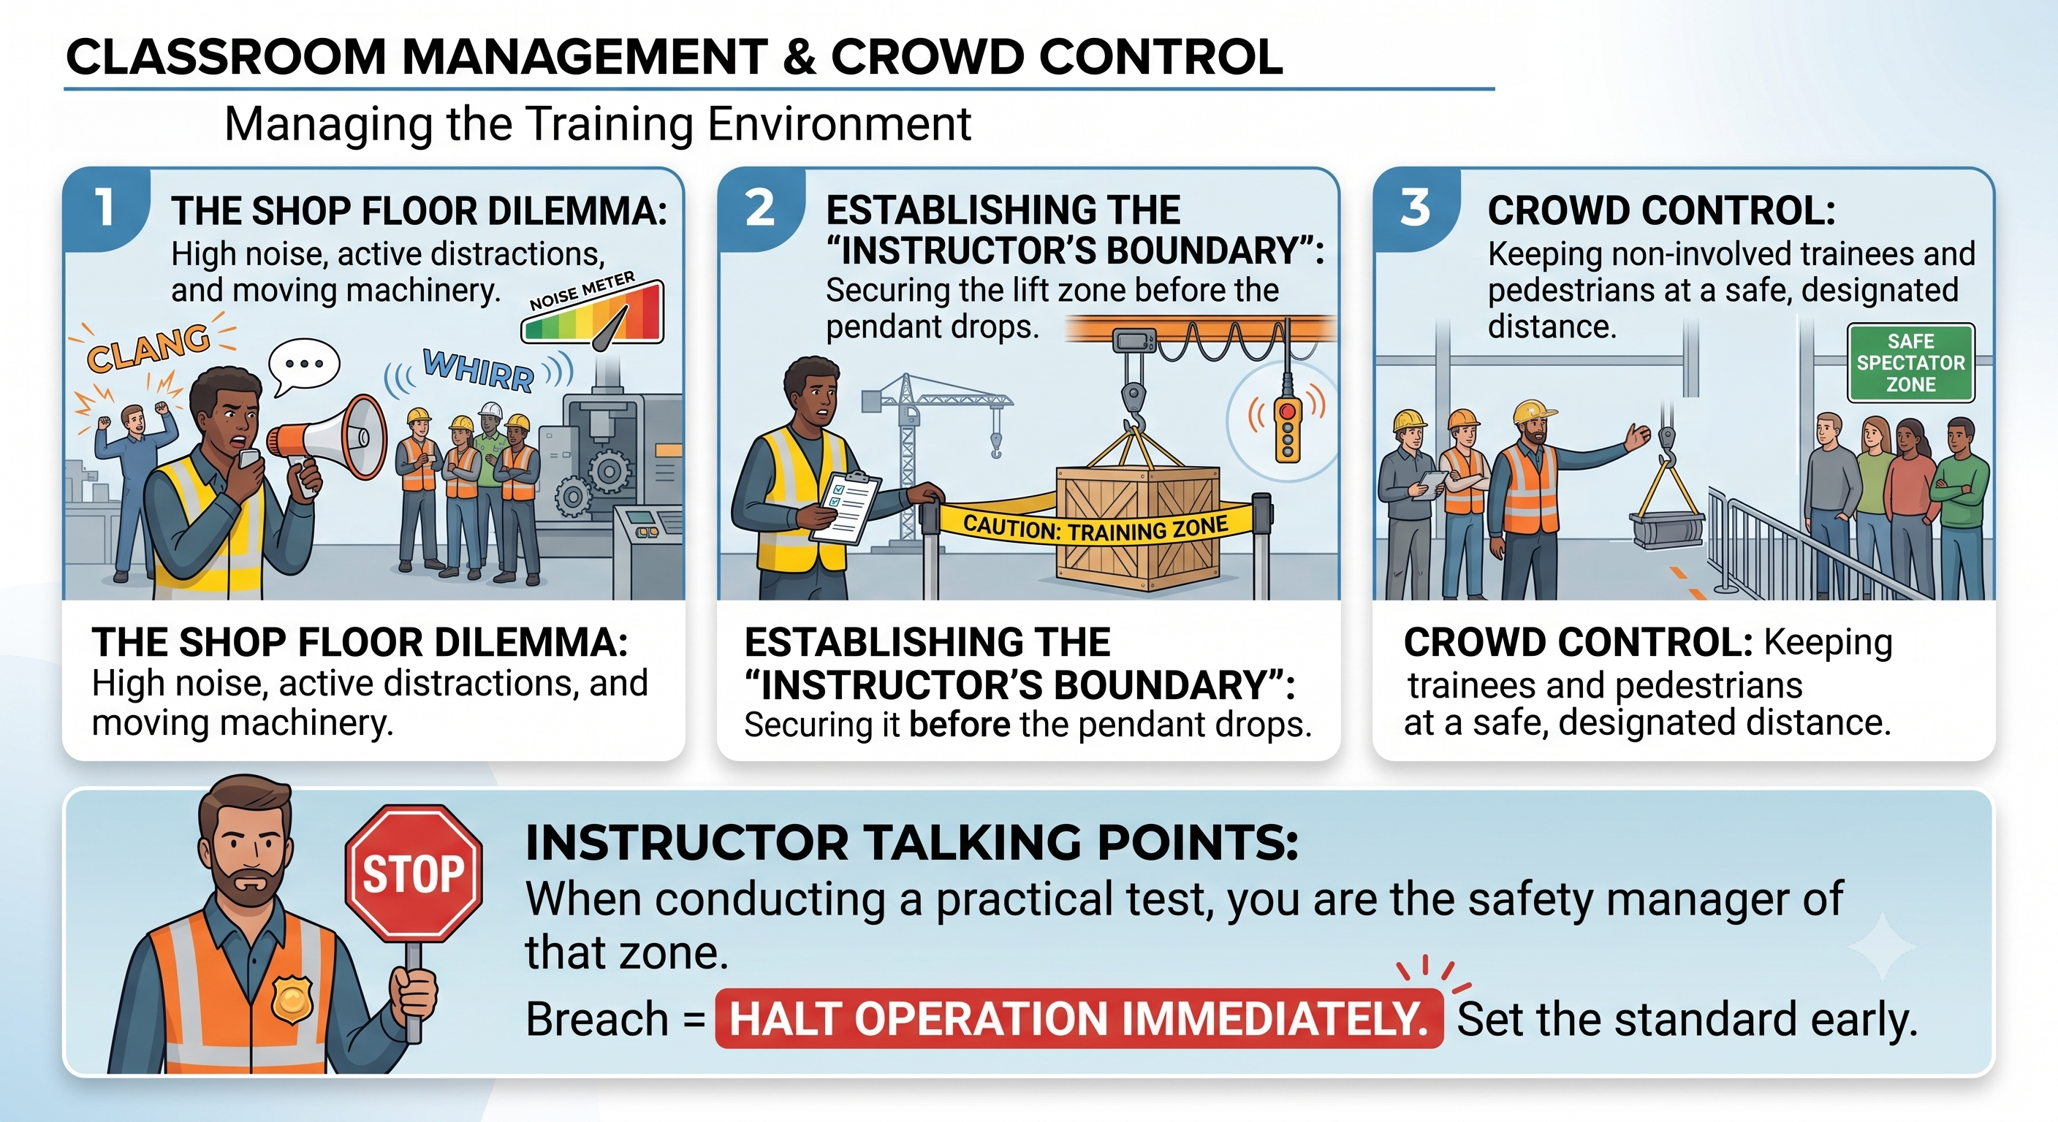
Module 1: Foundations of Instructional Delivery

Slide 8
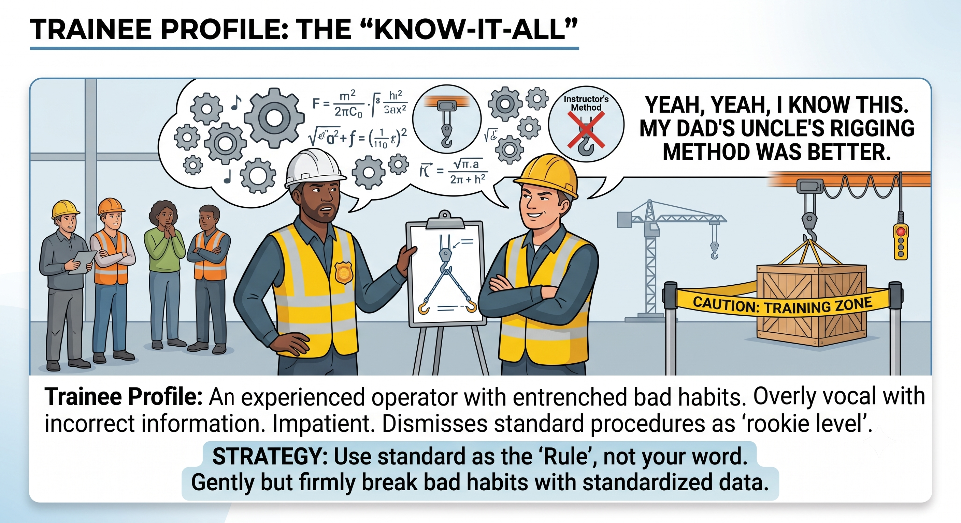
Module 1: Foundations of Instructional Delivery
Handling Training Challenges (The 3 Types)

Slide 9
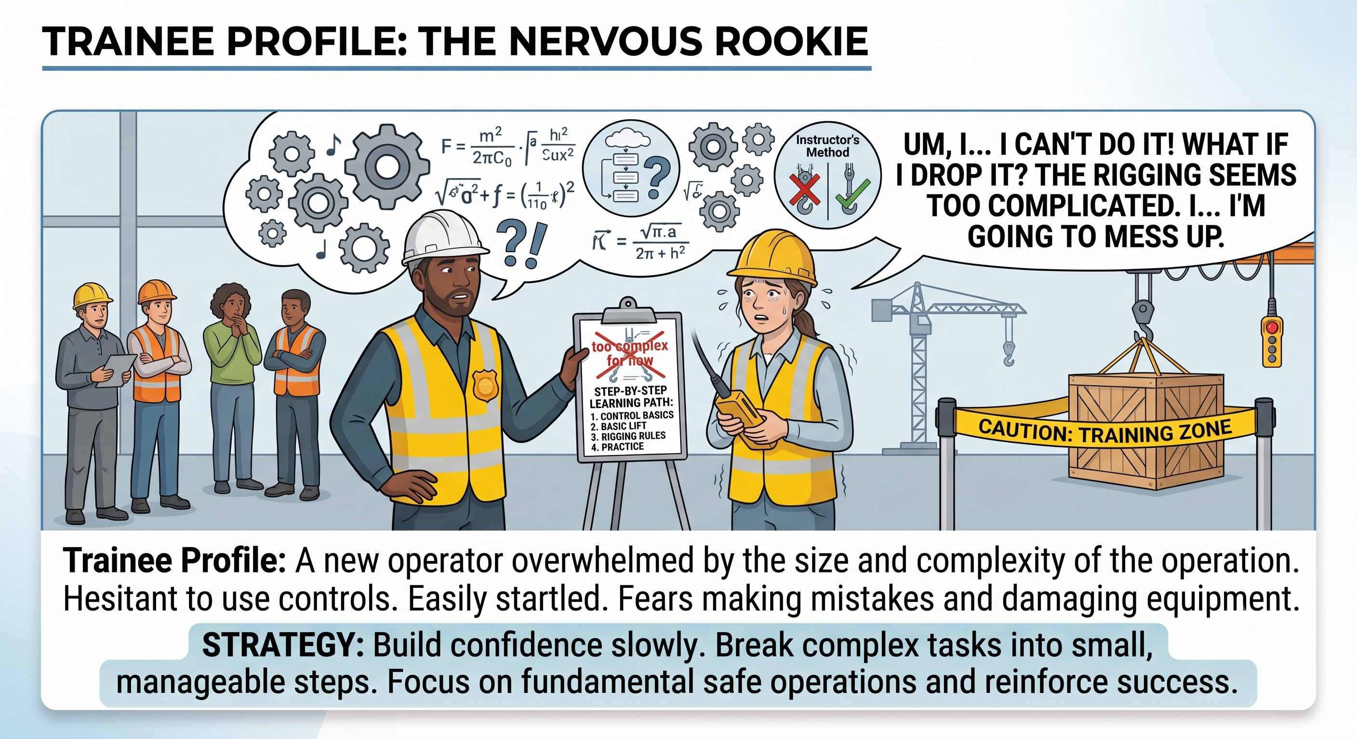
Module 1: Foundations of Instructional Delivery
Handling Training Challenges (The 3 Types)

Slide 10
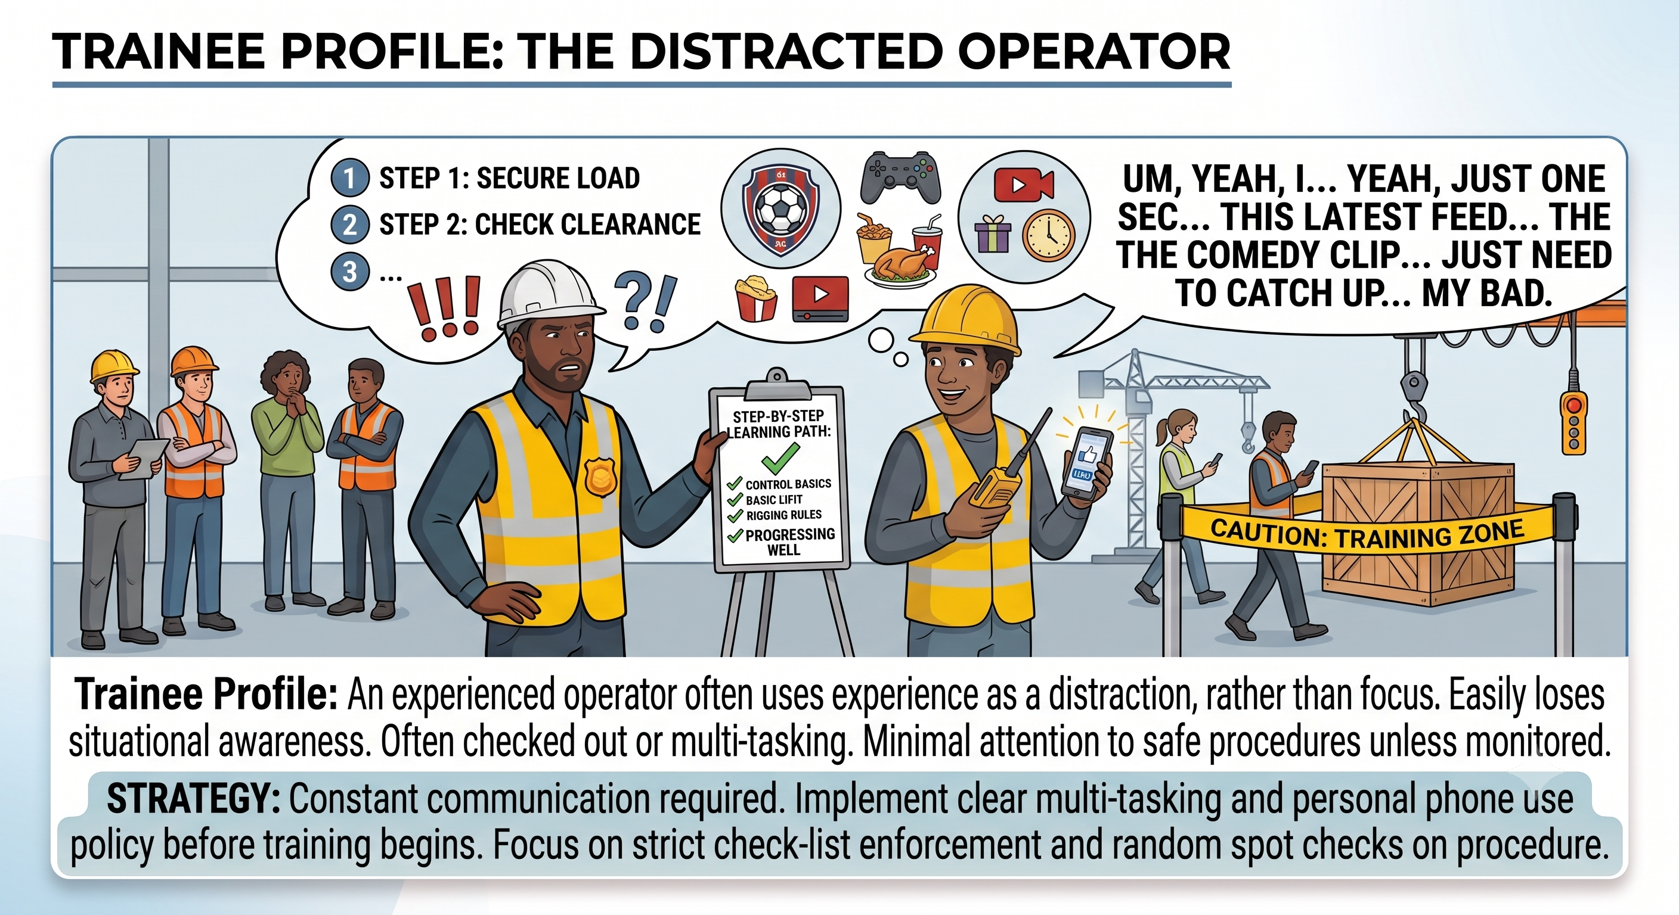
Module 1: Foundations of Instructional Delivery
Handling Training Challenges (The 3 Types)

Slide 11
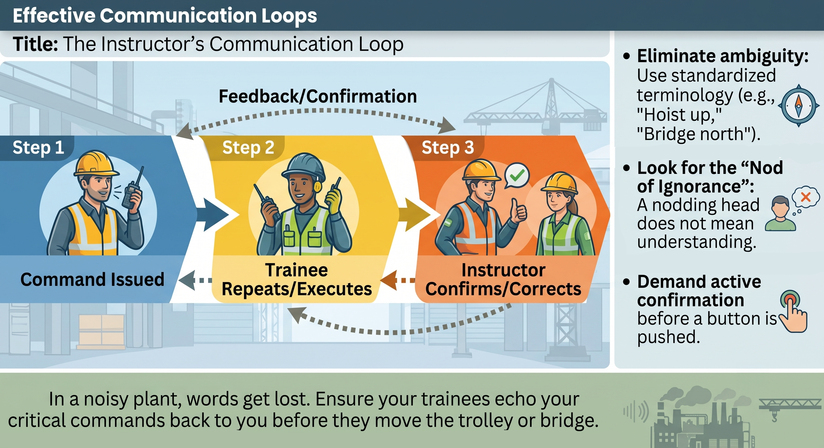
Module 1: Foundations of Instructional Delivery

Slide 12
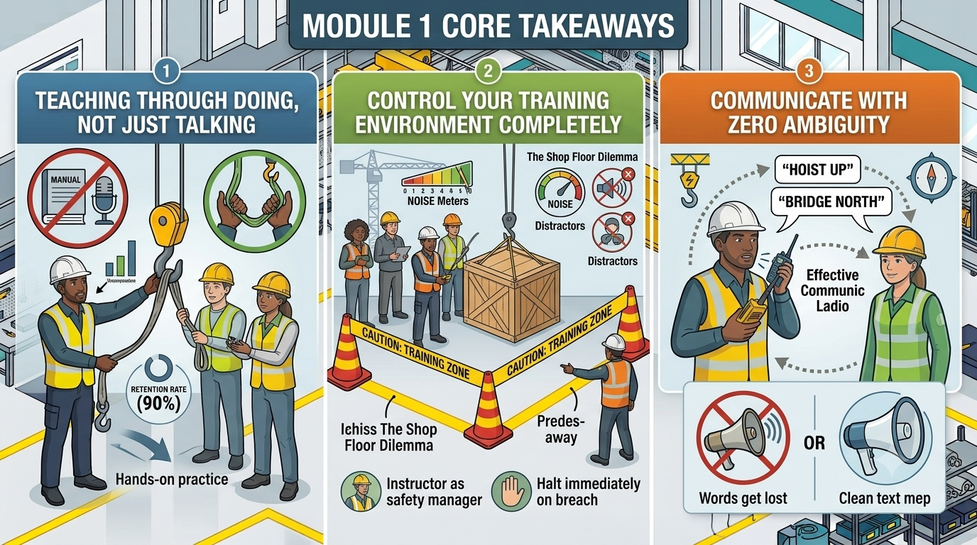

Slide 13
Module 2: Core Curriculum Mastery

Slide 14
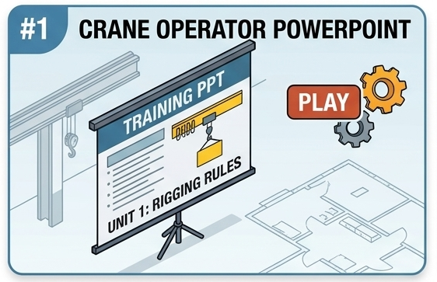
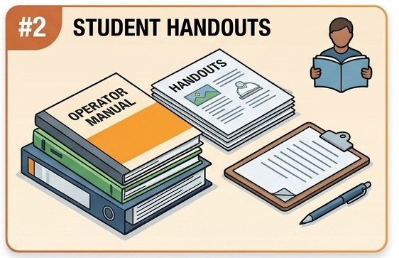
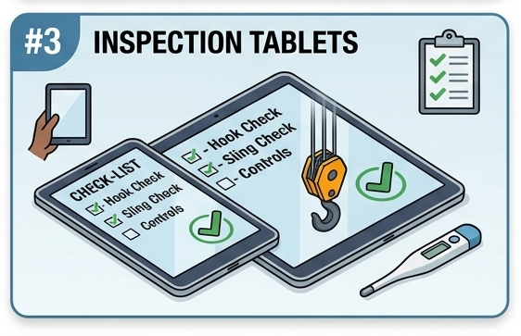
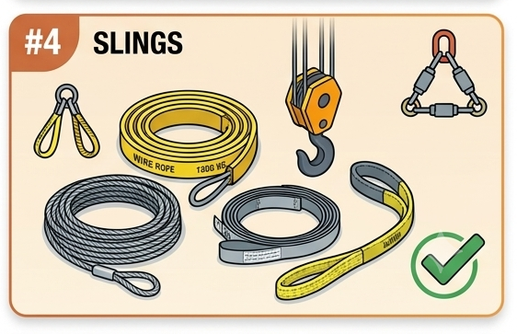
Module 2: Deconstructing the Technical Content for Trainees
SAF-T-1000 Crane and Hoist Operator Training - Instructor Guide.pptx
SAF-T-1001 Crane and Hoist Operator Training.pptx
G:\Safety\Safety Training\Crane and Hoist
SAF-T-1002 Crane and Hoist Student Handouts

Slide 15
Module 2: Deconstructing the Technical Content for Trainees
Slide 1: Module Title Slide
Visual: Blueprint-style graphics or clear photos of a Jib crane, a Bridge crane, and a Gantry crane side-by-side.
Title: Module 2: Core Curriculum Mastery
Subtitle: Deconstructing the Technical Content for Trainees
Instructor Talking Points:
  In this module, we review the exact core topics you will be teaching.
  Remember, you know this stuff like the back of your hand, but your trainees won't. We are going to focus on the common mistakes rookies make and the absolute non-negotiables for each crane type.

Slide 16
Slide 2: Demystifying Crane Types (Jib, Bridge, & Gantry)
Title: Teaching Crane Architecture & Structural Hazards
Bullet Points:
  Jib Cranes: Wall vs. pillar mounts. Boom rotation hazards and the danger of "boom drift."
  Bridge Cranes: Runway tracks, end-truck alignment, and overhead building clearances.
  Gantry Cranes: Floor tracks or polyurethane wheels. Leg impact hazards and floor debris obstructions.
Instructor Talking Points:
  When training a rookie, make sure they visually check the physical limits of the crane before operating.
  Remind your trainees that Jib cranes can rebound or drift if stopped suddenly, and Gantry legs at floor level are a major hazard for anyone walking in the bay.

Slide 17
Slide 3: Controller Mechanics – Pendant Safety
Title: Teaching Pendant Operation
Bullet Points:
  Body Positioning: Walking with the load, never under it or in the path of travel.
  Cord Management: Avoiding tripping hazards and preventing snagging on floor machinery.
  Strain Relief: Teaching trainees never to pull the bridge or trolley by the pendant cord itself.
Instructor Talking Points:
  Rookies often walk backward while watching the load, which is a major tripping hazard. Teach your trainers to enforce the "look at your path, then look at the load" sequence.

Slide 18
Slide 4: Controller Mechanics – Belly-Box (Radio) Safety
Title: Teaching Belly-Box (Wireless) Operation
Bullet Points:
  The Line-of-Sight Rule: Maintaining a clear view of the crane and the load at all times.
  Accidental Actuation: Powering down the remote when rigging, tagging, or stepping away.
  Battery & Ergonomics: Proper harness adjustment to prevent fatigue and accidental bumping of joysticks.
Instructor Talking Points:
  Wireless remotes introduce a massive risk: operating from around a corner or while blinded. Stress to your future trainers that the belly-box must be switched off completely during rigging so a bumped lever doesn't crush a hand.

Slide 19
Slide 5: Teaching Pre-Shift Inspections
Title: The "No-Go" Inspection Criteria
Visual/Photos: Close-up examples of a stretched hook, a missing safety latch, and a frayed wire rope.
Bullet Points:
  The Critical Five: Hook & Latch, Wire Rope/Chain, Limit Switches, Controls, and Unusual Noises.
  Testing the Upper Limit Switch: Driving the block up slowly without a load to ensure it stops.
  Documentation: How to teach trainees to properly log an inspection and lock out a failed crane.
Instructor Talking Points:
  Trainees love to skip paperwork. Show your trainers how to instill the "Inspect Every Shift" habit. Emphasize that testing the upper limit switch at the start of the day is a lifesaver.

Slide 20
Slide 6: Rigging Fundamentals for Rookies
Title: Breaking Down Rigging & Hitches
Bullet Points:
  Sling Selection: Identifying capacity tags (Synthetic vs. Chain vs. Wire Rope).
  The 3 Basic Hitches: Vertical, Choker, and Basket.
  Center of Gravity (CG): Teaching trainees how to locate the CG so the load doesn't tilt or swing violently when lifted.
Instructor Talking Points:
  Rigging is where most crane accidents occur. Your trainers need to know how to teach basic sling angles. If a trainee can't find the capacity tag on a sling, that sling is dead to them—teach your trainers to enforce this rule strictly.

Slide 21
Slide 7: Communication, Hand Signals, & Crowd Control
Title: Controlling the Lifting Zone
Bullet Points:
  Standardized Hand Signals: Enforcing OSHA/ASME signals—no "custom" hand-waving.
  The Emergency Stop Rule: Anyone can give the stop signal, and the operator must obey it.
  Zone Defense (Crowd Control): Clearing pedestrians out of the travel path before the load lifts.
Instructor Talking Points:
  Direct your trainers to watch for "polite" operators who are afraid to yell at pedestrians or drop a horn/klaxon. If anyone walks under or near the load, the operator must stop the crane immediately.

Slide 22
Module 3: Micro-Teaching Assignments

Slide 23
Slide 1: Module Title Slide
Visual: A photo of a trainer standing at a whiteboard or next to a crane, actively coaching a small group.
Title: Module 3: Micro-Teaching Assignments
Subtitle: Putting Your Instructor Skills to the Test
Instructor Talking Points:
  It’s time to step up to the front of the room.
  In this module, we are assigning your 15-minute "Teach-Back" topics. This is your opportunity to practice delivery, manage a simulated classroom, and receive constructive feedback before you ever train a real student on the shop floor.

Slide 24
Slide 2: The Teach-Back Rules of Engagement
Title: Teach-Back Parameters & Expectations
Bullet Points:
  Strict 15-Minute Time Limit: You must introduce, teach, and summarize your topic within the window.
  Target Your Audience: Treat your classmates as "green" trainees who have never touched a crane.
  Incorporate Visuals/Props: Use the actual equipment, pendants, rigging hardware, or slide material provided.
  Engage the Room: Do not just read to us; ask questions and verify understanding.
Instructor Talking Points:
  In the real world, time management is crucial. If you run over 15 minutes here, it means your future field training will drag out or miss critical points.
  Keep it focused, interactive, and heavy on safety.

Slide 25
Slide 3: Topic Assignments (The Drawing Board)
Title: Choose / Assign Your 15-Minute Topic
Two-Column Layout/List:
  Topic 1: Pre-Shift Hoist Limit Switch Testing
  Topic 2: OSHA/ASME Hand Signals Mastery
  Topic 3: Synthetic Sling Inspection & Removal Criteria
  Topic 4: Safe Positioning & Paths with a Pendant Controller
  Topic 5: Belly-Box Lockout & Accidental Actuation Prevention
  Topic 6: Pedestrian Control & Zone Defense (Crowd Control)
  Topic 7: Finding Center of Gravity & Basic Hitch Selection
  Topic 8: Jib Crane Specifics & Managing Boom Drift
Instructor Talking Points:
  [Distribute or draw the topics here]
  You have the next [X minutes/hours or overnight] to prepare your lesson plan. Use the Instructor Guide we reviewed in Module 2 as your foundational material, but bring your own teaching style to it.

Slide 26
Slide 4: The Evaluation Rubric (How You Are Scored)
Title: What Does Success Look Like?
Table: | Evaluation Criteria | High Performance | Needs Improvement | | :--- | :--- | :--- | | Safety Focus | Enforces 100% compliance; calls out simulated hazards instantly. | Ignores a safety error or skips a critical warning. | | Clarity & Tone | Uses clear, non-ambiguous commands and simple terminology. | Uses confusing jargon or speaks too quietly for a shop. | | Engagement | Asks trainees questions; utilizes the communication loop. | Lectures straight to the wall/screen without looking at students. | | Time Management | Hits the introduction, body, and summary in 15 mins. | Gets stuck on one detail and fails to finish the lesson. |
Instructor Talking Points:
  We aren't grading you on being a professional public speaker. We are grading you on whether your trainee walks away knowing how to stay alive and protect the equipment.

Slide 27
Slide 5: Peer Feedback Protocols
Title: The Role of the Audience
Bullet Points:
  Play Along, Don't Sabotage: Act like real trainees, but don't intentionally derail your classmate.
  The "Feedback Sandwich": When critiquing, give a positive note, a specific area to correct, and end with encouragement.
  Observe and Learn: Watch what works well for others and steal those techniques for your own toolkit.
Instructor Talking Points:
  We are a team here. Your feedback to your peers is just as important as mine. Be honest, be professional, and help each other improve.

Slide 28
Module 4: Evaluation and Coaching Methods

Slide 29
Slide 1: Module Title Slide
Visual: An instructor holding a clipboard/tablet, actively checking off boxes while closely observing an operator navigate a load through an obstacle course.
Title: Module 4: Evaluation & Coaching Methods
Subtitle: Measuring Competency and Delivering Feedback
Instructor Talking Points:
  Teaching someone how to use a crane is only half the battle. The other half is evaluating whether they are actually safe enough to be cut loose on the floor.
  In this module, we will cover how to coach through mistakes, how to use the evaluation checklist objectively, and how to deliver feedback that builds confidence without compromising safety standards.

Slide 30
Slide 2: Intervention – When to Step In
Title: Verbal Coaching vs. Physical Intervention
Bullet Points:
  Level 1: Verbal Guidance: Trainee is safe but awkward (e.g., over-correcting a swing). Let them work through it while giving verbal tips.
  Level 2: Verbal Correction: Trainee is drifting toward a minor error (e.g., forgetting to check their travel path). Call it out immediately.
  Level 3: Physical Intervention: Immediate safety hazard (e.g., load about to strike an object, walking under a load). Take the control or command an Emergency Stop.
Instructor Talking Points:
  It is hard to watch a beginner struggle, but if you step in too early, they never learn. However, you cannot let a struggle become a hazard.
  If you are training on a Belly-Box wireless remote, keep your hand near the power switch or keep the backup controller/E-stop ready. If they breach a safety boundary, kill the operation instantly.

Slide 31
Slide 3: Delivering the "Feedback Sandwich"
Title: Correcting Bad Habits Safely
Visual/Graphic: A three-layer sandwich diagram: Positive Reinforcement $\rightarrow$ Correction/Adjustment $\rightarrow$ Future Encouragement.
Bullet Points:
  Praise the Good: Acknowledge what they did right first (e.g., "Your pre-shift inspection was flawless").
  Correct the Critical: Address the specific safety or operational gap clearly (e.g., "However, you forgot to clear the pedestrians in Bay 3 before moving the bridge").
  End with Action: Give them a clear goal for the next attempt (e.g., "On this next lift, focus on your crowd control first, and you’ll have this down").
Instructor Talking Points:
  If you just chew a trainee out, they shut down and stop listening. If you just tell them they did great when they made a dangerous mistake, you are setting them up for an accident. Use this structured approach to keep them focused and receptive.

Slide 32
Slide 4: Objective vs. Subjective Grading
Title: Using the Practical Evaluation Checklist
Two-Column Layout:
  Subjective (Avoid This): "Yeah, they seemed pretty comfortable with the pendant." or "They moved a bit too fast for my liking."
  Objective (Do This): "Operator maintained a minimum 3-foot clearance from obstacles." or "Operator failed to test the upper limit switch."
Bullet Points:
  Base your pass/fail decisions entirely on documented, observable actions.
  If it isn't on the checklist, don't grade them on it. If it is on the checklist, do not give them a "free pass."
Instructor Talking Points:
  Being consistent prevents arguments and protects the company. If an operator fails their test, the checklist should clearly show why they failed based on black-and-white safety metrics, not your personal opinion.

Slide 33
Slide 5: Documenting the Results
Title: Compliance and Paperwork Protocols
Bullet Points:
  Signatures matter: Both the trainer and the trainee must sign off on the completed practical evaluation.
  Remediation plans: If a trainee fails, document the exact areas needing improvement and the required practice hours before their re-test.
  Keep it professional: Your evaluation notes are official company safety records. Keep comments strictly factual.
Instructor Talking Points:
  If an incident happens six months from now, OSHA will look at your evaluation paperwork. Make sure it is detailed, accurate, and signed.

Slide 34
Module 5: Practical Hands-On Evaluations

Slide 35
Slide 1: Module Title Slide
Visual: A clear, professional graphic of a clipboard with a roadmap icon or a 1-on-1 coaching graphic.
Title: Module 5: Your Practical Evaluation Roadmap
Subtitle: Process, Scheduling, and Private 1-on-1 Testing
Instructor Talking Points:
  Now that we've covered adult learning and how to evaluate others, it’s time to talk about your final milestone: your own practical teaching evaluation.
  Today, we are going to look at exactly how you will be tested, how to schedule your session, and how we ensure a private, low-pressure testing environment.

Slide 36
Slide 2: The Evaluation Format – Purely 1-on-1
Title: A Private, Focused Testing Environment
Bullet Points:
  Zero Peer Observation: No classmates will be in the bay watching or listening to your evaluation.
  The Setup: It will be just you, me (the Master Instructor), and a designated "trainee" for you to teach.
  The Goal: To simulate a real-world, distraction-free training environment where you can focus entirely on your student.
Instructor Talking Points:
  I know testing can be stressful, especially in front of your peers. That's why we completely eliminate the audience for this cap-stone.
  You will not be put on display. This is a private, professional 1-on-1 validation of your skills as an instructor.

Slide 37
Slide 3: What You Will Be Asked to Do (The Live Phase)
Title: The Three Phases of Your Practical Exam
Visual/Flowchart: Phase 1: The Briefing $\rightarrow$ Phase 2: The Lift Execution $\rightarrow$ Phase 3: The Wrap-Up & Paperwork
Bullet Points:
  Phase 1 (Briefing): You will walk your trainee through a pre-shift crane inspection (Jib, Bridge, or Gantry) and review the controls.
  Phase 2 (Execution): You will coach your trainee through rigging a load, managing crowd control, navigating the path using a pendant or belly-box, and setting it down safely.
  Phase 3 (Debrief): You will complete the evaluation paperwork and deliver a "feedback sandwich" directly to your trainee.
Instructor Talking Points:
  I will be acting as a silent observer. I am not looking for perfection from your trainee—I am looking at how you guide them, how you correct their mistakes, and how you maintain total safety control over the crane bay.

Slide 38
Slide 4: Grading Metrics & Automatic Failures
Title: What the Master Instructor is Looking For
Bullet Points:
  Safety Proactivity: Did you stop the trainee if they walked under a load or ignored a pedestrian?
  Control Command: Did you enforce the proper communication loop and clear commands?
  Patience & Tone: Did you remain calm and constructive while they struggled with a maneuver?
  Automatic Failures: Allowing a major safety breach without intervening, or failing to check the upper limit switch/inspections.
Instructor Talking Points:
  If your trainee makes a mistake, that doesn't mean you fail. You only fail if you let them make a dangerous mistake without correcting it. You are the safety backstop.

Slide 39
Slide 5: Scheduling Your Evaluation Session
Title: Booking Your Testing Window
Bullet Points:
  Duration: Allocate exactly 45 minutes for your private session (30 minutes for the test, 15 minutes for your personal debrief with me).
  Availability Openings: [Insert dates/times, e.g., Wednesday Afternoon / Thursday Morning]
  Sign-Up Process: Review the physical sign-up sheet on the back wall [or digital link] before leaving today.
  Preparation: Arrive 10 minutes early to your scheduled slot to review your materials and ensure the crane bay is clear.
Instructor Talking Points:
  Please check your production and shift schedules before signing up. We want to ensure you have a clear mind and aren't rushing back to the floor immediately after your slot.

Slide 40
Slide 6: Final Q&A and Sign-Up Wrap-Up
Title: Next Steps to Certification
Bullet Points:
  Review your Module 2 & 4 notes before your scheduled time.
  Secure your 45-minute timeslot before the end of the day.
  Ask any lingering questions about the curriculum or expectations now.

Slide 41
Module 6: Administration & Compliance

Slide 42
Slide 1: Module Title Slide
Visual: A graphic of a standardized compliance folder, a digital database dashboard, or a clean training log.
Title: Module 6: Administration & Compliance
Subtitle: Protecting the Operator, the Trainer, and the Company
Instructor Talking Points:
  We’ve covered how to teach and how to evaluate. This final module covers how to document.
  In the safety world, if it isn't documented, it didn't happen. We will walk through the exact paperwork required to make an operator's certification official and compliant with OSHA standards.

Slide 43
Slide 2: Why Compliance Documentation Matters
Title: The Legal Backbone of Safety Training
Bullet Points:
  OSHA 1910.179 Requirement: The employer must ensure operators are fully trained and deemed competent.
  The Paper Trail: In the event of an audit or incident, training records are the first thing requested.
  Trainer Accountability: Your signature certifies that the trainee met every single safety metric on that day.
Instructor Talking Points:
  Good documentation isn't just bureaucratic busywork—it is legal protection. If an operator bypasses a safety rule months from now and causes an incident, your detailed evaluation checklist proves the company provided the proper training and enforced the correct standard.

Slide 44
Slide 3: Filling Out the Official Training Records
Title: Step-by-Step: The Authorized Paperwork
Visual/Image: A labeled mockup or highlighted screenshot of your company’s actual Crane Operator Training Log and Certification form.
Bullet Points:
  Core Fields Required: Full name, associate ID, date of training, and the specific equipment type (e.g., Jib, Bridge, Gantry).
  Controller Type Specifics: You must explicitly check off whether they are certified for Pendant, Belly-Box, or both.
  The Two Necessary Signatures: The Trainer's signature (verifying competency) and the Trainee's signature (acknowledging they received and understood the training).
Instructor Talking Points:
  Make sure you write legibly and fill out every single block. Do not leave the controller type blank. If you only evaluated them on a pendant, do not clear them to use a wireless belly-box remote.

Slide 45
Slide 4: Re-Certification & Refresher Timelines
Title: Maintaining Certified Status
Bullet Points:
  Standard Evaluation Window: Crane operator practical evaluations must be refreshed at regular intervals [insert company specific interval, e.g., every 3 years].
  Trigger Events for Immediate Retraining:
    The operator is involved in a near-miss or an accident.
    The operator is observed operating the crane in an unsafe manner.
    The operator is assigned to a brand-new crane type they haven't used before.
Instructor Talking Points:
  Don't wait for the multi-year expiration date if you see something wrong. As an authorized trainer, if you catch a certified operator flying a load over a pedestrian's head or dragging a load with a pendant cable, you have the authority—and the responsibility—to pull their authorization and mandate immediate refresher training.

Slide 46
Slide 5: Filing and Submitting the Paperwork
Title: Where Does the Paperwork Go?
Bullet Points:
  Step 1: Scan and save the completed, signed evaluation sheet to the digital training matrix.
  Step 2: Route the original physical hardcopy to [insert department, e.g., EHS Department / Human Resources] within 48 hours of completion.
  Step 3: Issue the operator their updated credentials [e.g., digital badge update, physical license card, or training matrix update].
Instructor Talking Points:
  Do not let completed evaluation forms sit in your toolbox or desk drawer. If an operator is running a crane on third shift and the supervisor checks the digital system, that record needs to be updated immediately so everyone knows they are clear to operate.

Slide 47
Slide 6: Course Wrap-Up & Next Steps
Title: Congratulations – You Are Ready
Bullet Points:
  Classroom training is now complete.
  Ensure your 45-minute private evaluation slot is booked on the sign-up sheet.
  Review your materials, and we will see you at your scheduled 1-on-1 session in the crane bay.
Instructor Talking Points:
  Thank you for your time, your focus, and your commitment to keeping our facility safe. You have the knowledge; now go get prepped for your 1-on-1 practicals. The floor is open for any final questions!

Slide 48
Module 6: Administration & Compliance

Slide 49
Slide 1: Course Summary Title Slide
Visual: A strong graphic or photo highlighting professional leadership, teamwork, or a clear view of an organized, safe plant floor.
Title: Course Summary & The Path Forward
Subtitle: Becoming a Champion for Safety Excellence
Instructor Talking Points:
  We have covered a lot of ground over the last couple of days. Before we close the classroom doors and transition to the crane bay for your private evaluations, let's bring it all together.
  This summary isn't just a review of the slides; it’s a final look at the mindset shift required to be a truly effective safety trainer.

Slide 50
Slide 2: The Core Frameworks of a Safety Leader
Title: Shifting the Culture on the Shop Floor
Bullet Points:
  The Systems Mindset: Training isn't just about teaching button-pushing; it’s about teaching how the operator fits into the entire plant ecosystem.
  Defensible Decision Making: Ensuring every pass/fail decision you make as a trainer is backed by black-and-white, objective criteria.
  The Safety Triad: Balancing equipment integrity, operator compliance, and proactive environmental control (crowd control).
Instructor Talking Points:
  When you step out onto the floor as an authorized trainer, you represent the highest standard of safety leadership.
  Use a Systems Mindset to help rookies understand why the rules exist, and protect yourself and the company by keeping your evaluations completely defensible and objective.

Slide 51
Slide 3: Your Instructor Checklist
Title: The 5 Cardinal Rules of a Crane Instructor
Numbered List:
  Never Take Your Eyes Off the Trainee: When they have the controller, your focus is entirely on them and the lift zone.
  Enforce the Communication Loop: Do not let a trainee move a bridge or trolley until they have confirmed your command.
  Protect the Boundary: Maintain absolute crowd control; halt the operation the second a pedestrian breaches the zone.
  Know the Controller Nuances: Strictly enforce pendant strain relief and wireless belly-box power-down protocols during rigging.
  Document Everything Factually: If it isn't signed, dated, and objectively noted on the checklist, it didn't happen.
Instructor Talking Points:
  If you commit these five principles to memory, your training sessions will be smooth, compliant, and—most importantly—safe.

Slide 52
Slide 4: Final Practical Exam Preparation Checklist
Title: What to Do Before Your 1-on-1 Evaluation
Bullet Points:
  Review Your Assigned Topic: Ensure you are completely comfortable delivering your specific 15-minute micro-teaching topic.
  Study the Evaluation Rubric: Know exactly what metrics I will be using to grade your performance as an instructor.
  Confirm Your Timeslot: Double-check your scheduled 45-minute private session window on the sign-up sheet.
  Arrive Prep-Ready: Show up 10 minutes prior to your slot with a clear mind, ready to lead your simulated trainee through the full briefing, lift, and debrief.
Instructor Talking Points:
  Treat your upcoming private test exactly like a real-world training day. I am there as a silent observer, rooting for you to succeed. Take a deep breath, rely on your years of operational expertise, and lead with confidence.

Slide 53
Slide 5: Open Forum & Final Dismissal
Title: Final Questions & Next Steps
Visual: The company logo alongside contact information for the Master Instructor / EHS department.
Bullet Points:
  Classroom training is officially concluded.
  Please ensure you have signed the classroom attendance roster before leaving.
  The floor is open for any final questions, comments, or clarifications.

