Slide 1
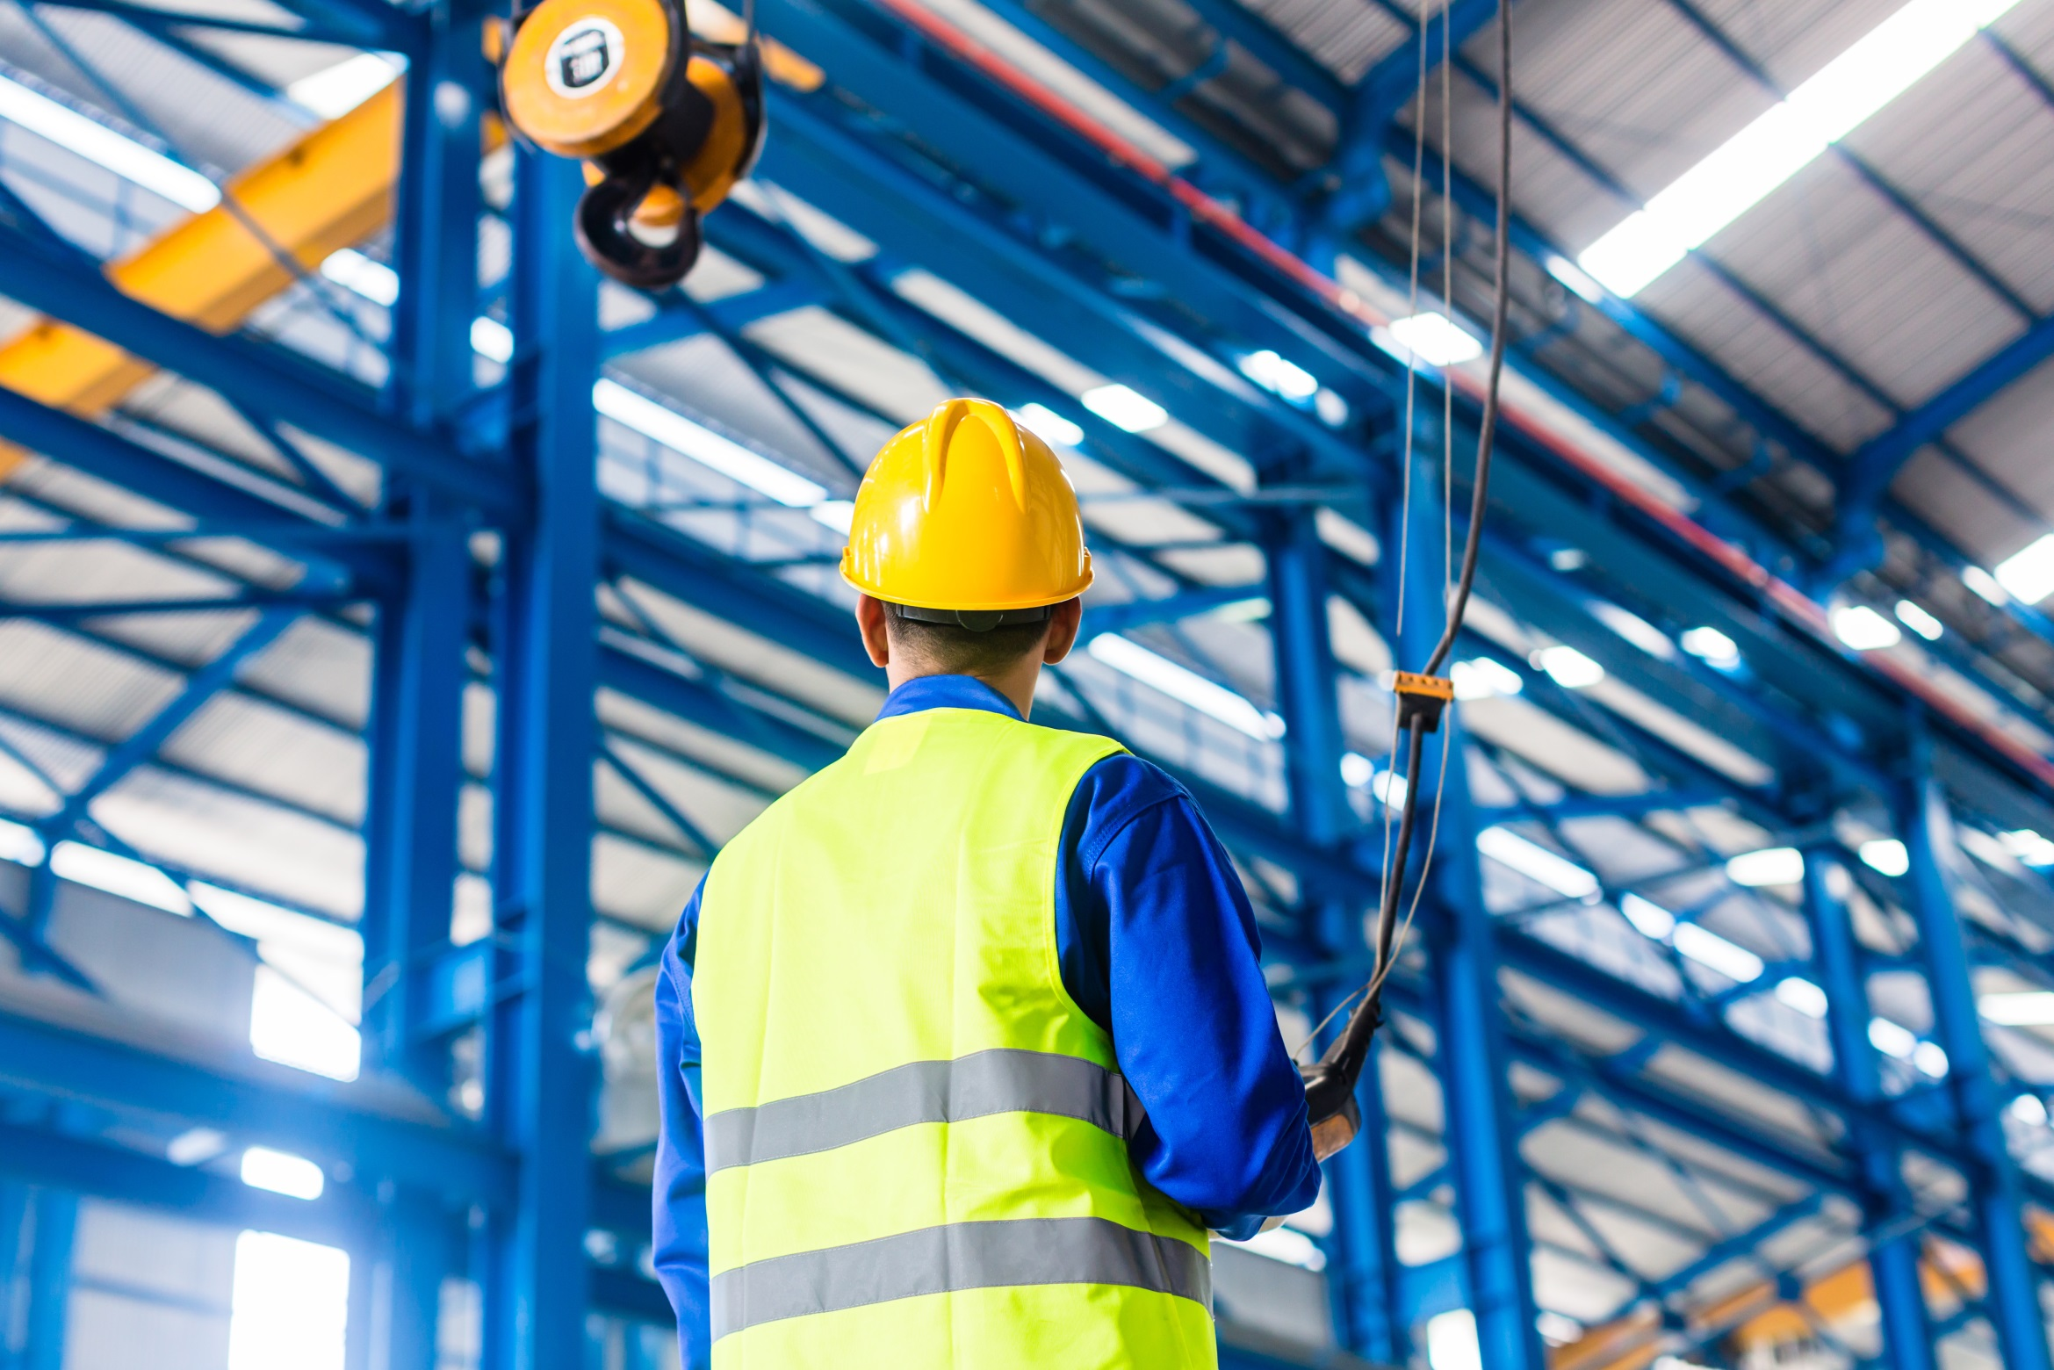

Crane & Hoist
Operator Training

Slide 2
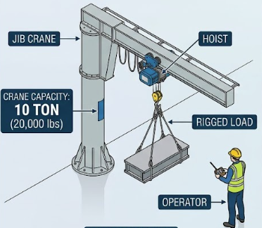
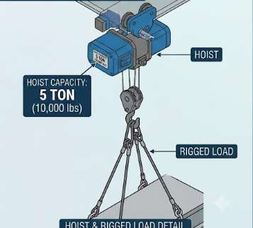
Crane
The support structure that holds the hoist.
When a forklift is used to lift loads under the forks, the truck is the crane.
Hoist
The lifting device that attaches to the crane.
When a forklift is used to lift loads under the forks, the forklift mast and forks are the hoist.
Rigging
Any and all devices that are used beneath the hoist to lift, support, or guide the load.

Slide 3
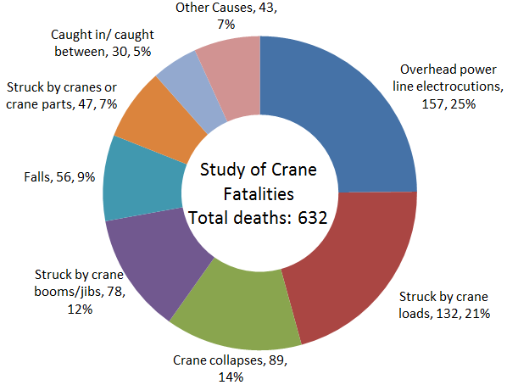
Frequent Causes of Crane Injuries and Property Damage
Cranes injuries are preventable when the cranes and rigging are:
Properly installed,
Properly inspected and maintained, and
Properly operated by trained personnel.
Failing to follow any of the three factors above can cause serious injury or even death.
The chart on the left shows the most frequent causes of crane-related fatalities.

Slide 4

Frequent Causes of Crane Injuries and Property Damage
Overhead Power Line Electrocutions
(25% of crane related fatalities)
Yaskawa associates only operate indoor cranes so the risk of electrocutions is very small.
The greatest risk occurs when using mobile cranes, including forklifts, near electrical conduit and buss ducts.
Remedy
Plan all aspects of your lift, including any overhead obstructions that may be in the path of your lift.

Slide 5
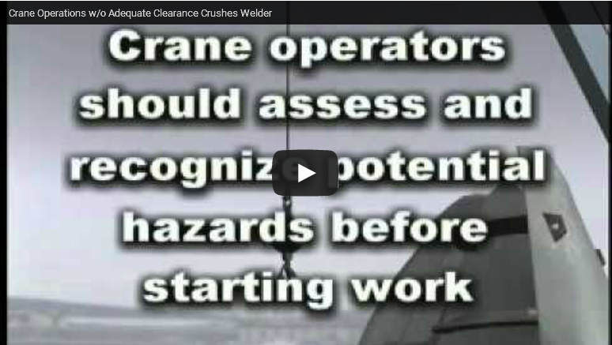
Frequent Causes of Crane Injuries and Property Damage
Struck by Crane Loads
(21% of crane related fatalities)
Being struck by a crane load is the highest risk crane related injury while operating cranes within Yaskawa.
These can include the following types of incident:
the load falls off of the rigging,
the rigging fails, or
the load strikes an associate.
  Even at slow speeds, the weight of the load can cause serious injury or death.
Remedy
Verify the capacity of the crane and rigging, including any de-rating, is sufficient to carry the load.
Daily and annual inspections of rigging.
Plan the lift, including the entire route the load will travel.
Keep bystanders/ unqualified associates away from the lift area.

Slide 6
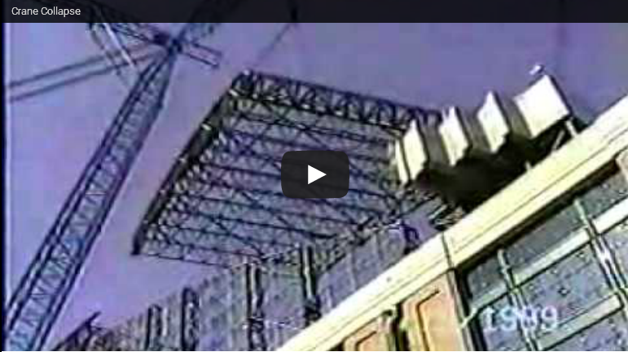
Frequent Causes of Crane Injuries and Property Damage
Crane Collapse
(14% of crane related fatalities)
If maximum weight is exceeded, the crane is in danger of either buckling of collapsing.
Remedy
Know the ratings of the crane and rigging
Know the weight of the load
Complete daily inspections
Ensure annual 3rd party inspections are complete
If the crane was improperly assembled and/or maintained, it is at risk of collapsing.
Remedy
3rd Party load inspection prior to use
Daily and annual inspections
Portable Cranes may tip over if the load center of gravity is not centered directly underneath the hitching.

Slide 7
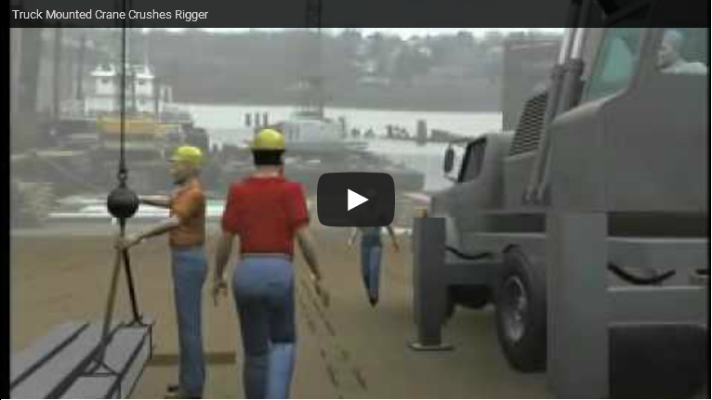
Frequent Causes of Crane Injuries and Property Damage
Caught In / Caught Between
(5% of crane related fatalities)
Cranes have moving parts, and the moving of the load makes it possible to be caught between the load and another object.
Remedy
Plan the route the load will travel.
Never place yourself between the load and a hard surface.
Plan an escape route in case something does go wrong.

Slide 8
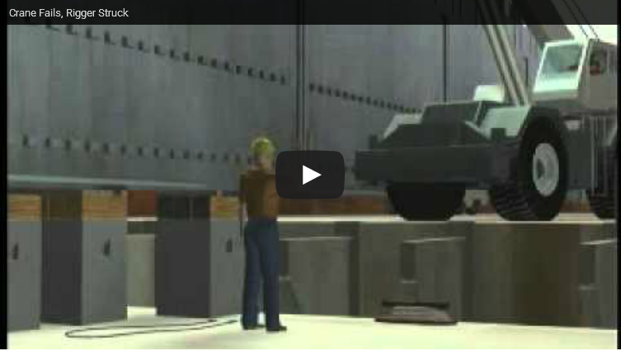
Frequent Causes of Crane Injuries and Property Damage
Improper Training
Although improper training was not included as the primary factor in the study, it was a contributing factor in each incident.
Remedy
Do not operate any equipment with which you have not been trained and with which you feel competent.
Do not allow untrained/unqualified personnel near the restricted zone.
Believe things can fail. Review your training materials frequently and avoid complacency.

Slide 9
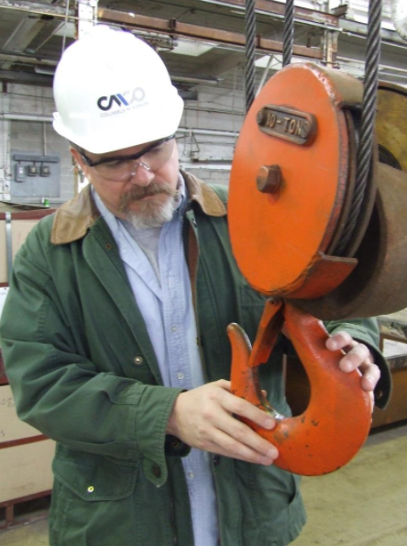
Daily Inspection
Before operating a crane,
Verify the crane, hoist, or rigging has not been locked out or tagged out.
Verify the crane has been inspected earlier that day
  If the crane was not inspected, notify your supervisor. DO NOT USE THE CRANE.
Check to make sure that everything passed inspection
  If anything failed, the crane should have been locked out.
  If anything failed and the crane has not been locked out, lock it out and notify your supervisor. DO NOT USE DEFECTIVE CRANES, HOISTS, or RIGGING
You are still responsible for your own safety. Double-check the crane, hoist, and rigging that you will use

Slide 10
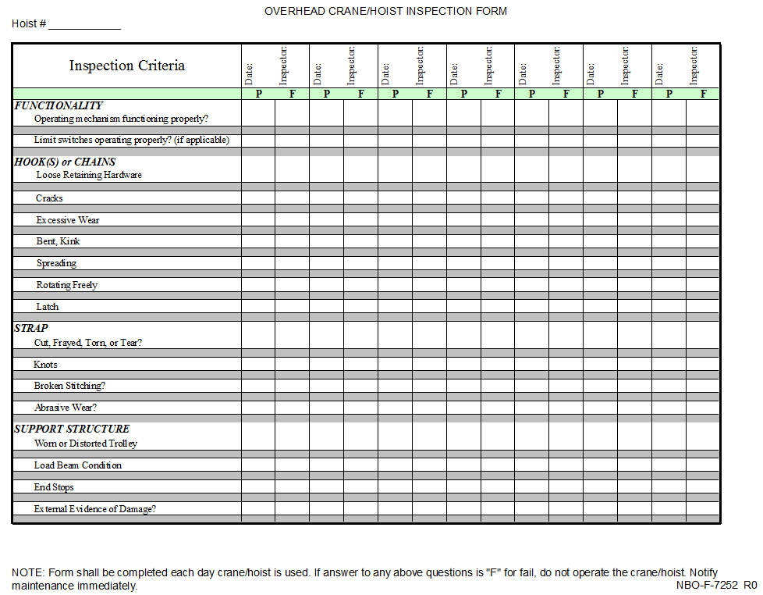
Daily Inspection

Slide 11
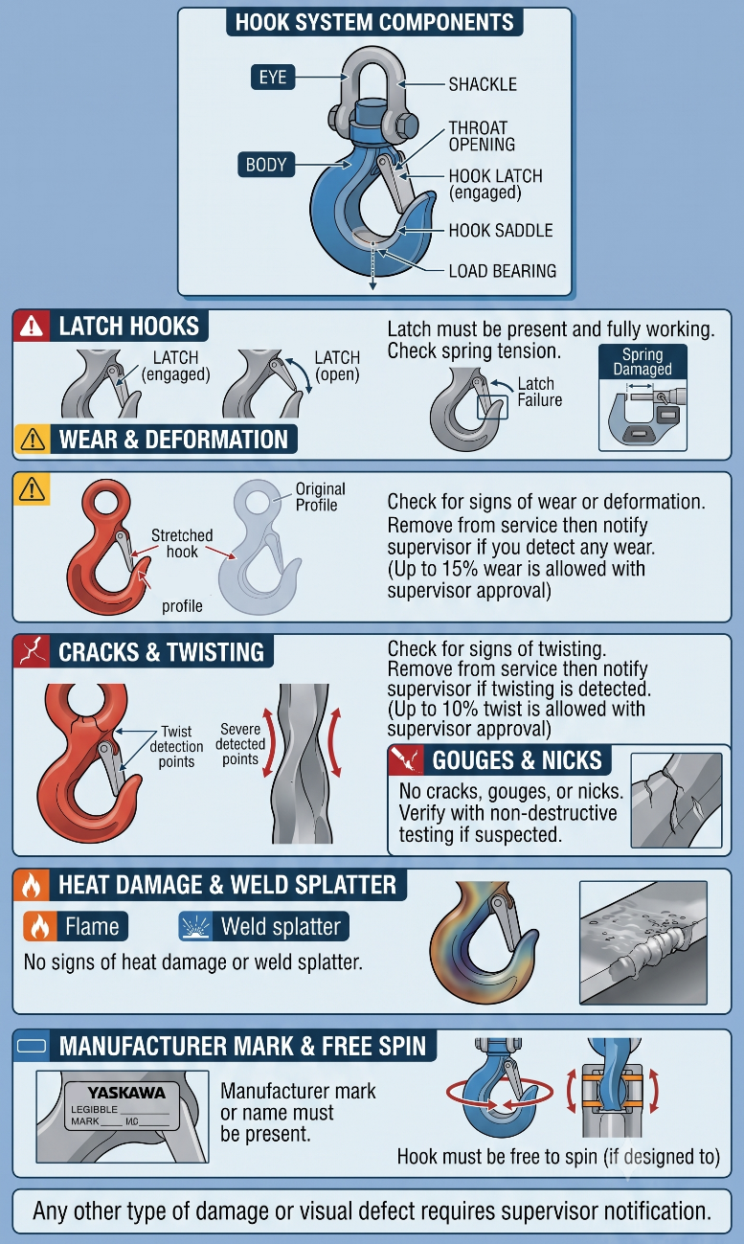
Daily Inspection
Hooks
For latch hooks (required on hoist hook), latch is in place and is working
To signs of wear or deformation
  Remove from service then notify supervisor if you detect any wear
  Up to 15% is allowed, if approved by lift supervisor
No cracks or twisting
  Remove from service then notify supervisor if you detect any twisting
  Up to 10% twist is allowed, if approved by lift supervisor
No cracks, gouges, or nicks
No signs of heat damage or weld splatter
Manufacturer mark or name is present
Hook is free to spin (if designed so)
Any other type of damage

Slide 12
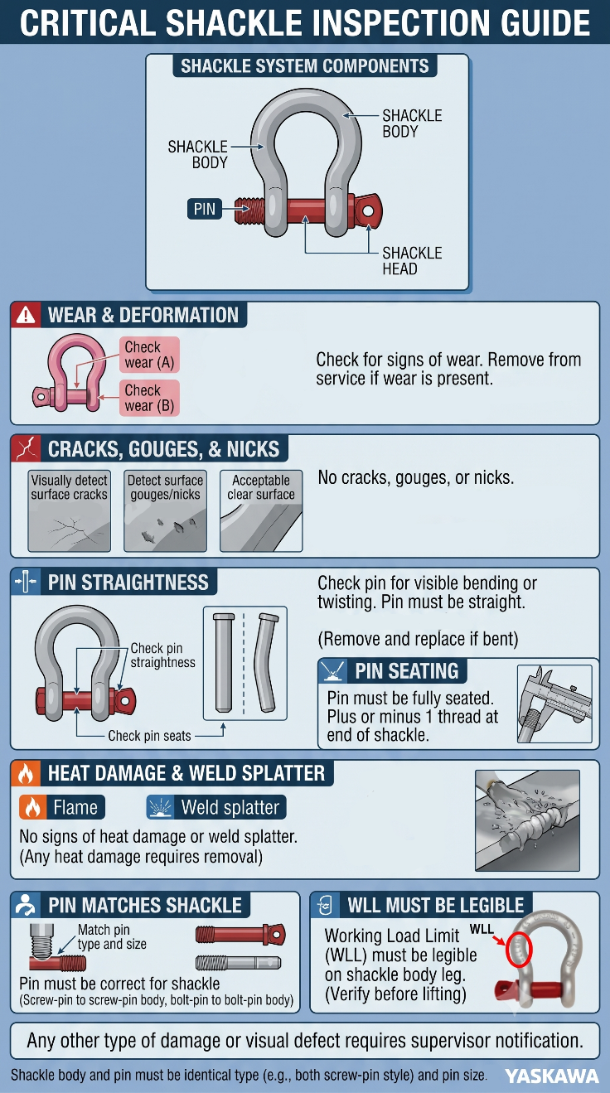
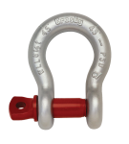
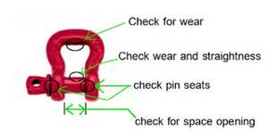
Daily Inspection
Shackles
No signs of wear
No cracks, gouges, or nicks
Pin is straight
Pin is fully seated
  (± 1 thread to end)
No heat damage or weld splatter
Pin matches shackle
WLL must be legible
WLL

Slide 13
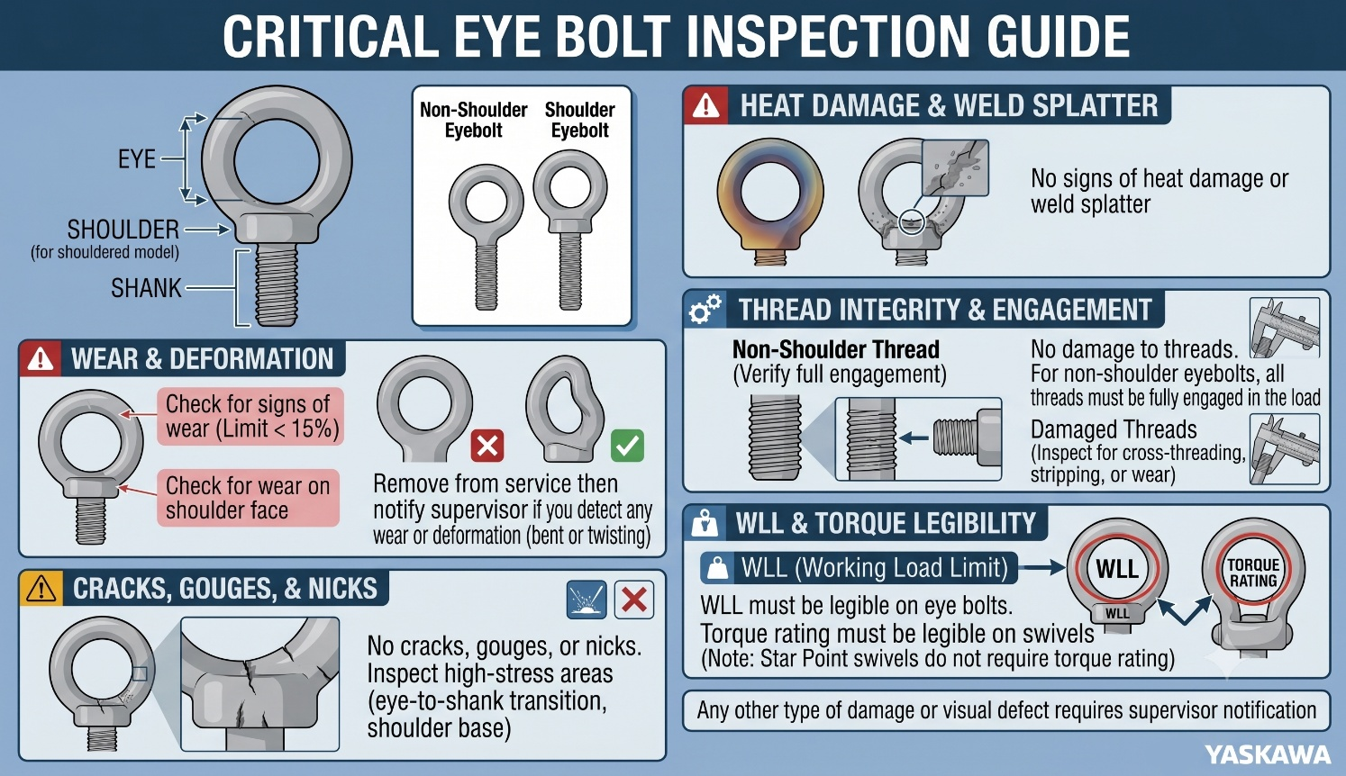
Daily Inspection
Eye Bolts & Swivels
No cracks, gouges, or nicks
No bends or twisting
No signs of wear
  Remove from service then notify supervisor
  Up to 15% wear may be approved by lift supervisor
No signs of heat damage or weld splatter
No damage to threads
WLL must be legible
Use of Eye Bolts & Swivels
Shoulder of eye bolt must sit flat against load
For non-shoulder eye bolt, all threads must be fully engaged
Torque rating must be legible on swivels
  Star Point swivel does not require torque

Slide 14
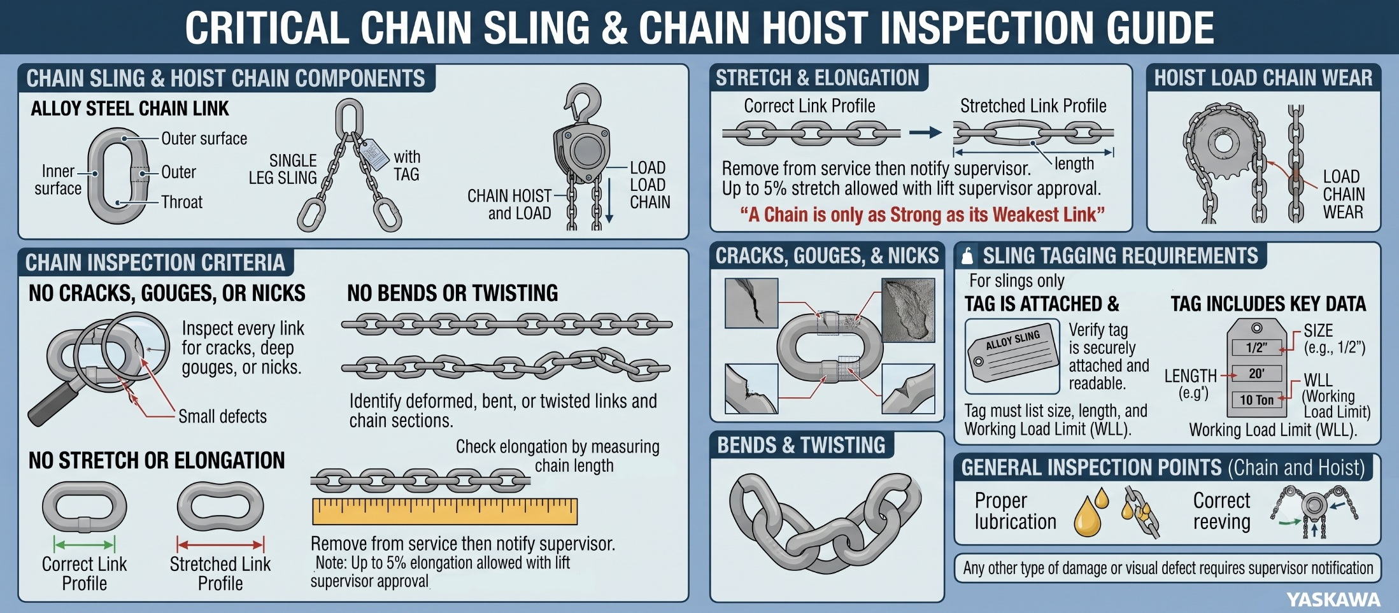
Daily Inspection
No cracks, gouges, or nicks
No bends or twisting
No stretch or elongation
  Remove from service & notify supervisor
  Up to 5% stretch or elongation may be approved by lift supervisor
For chain slings and bridles only:
  Tag is attached
  Tag includes the size, length, and WLL
  Tag is legible

Slide 15
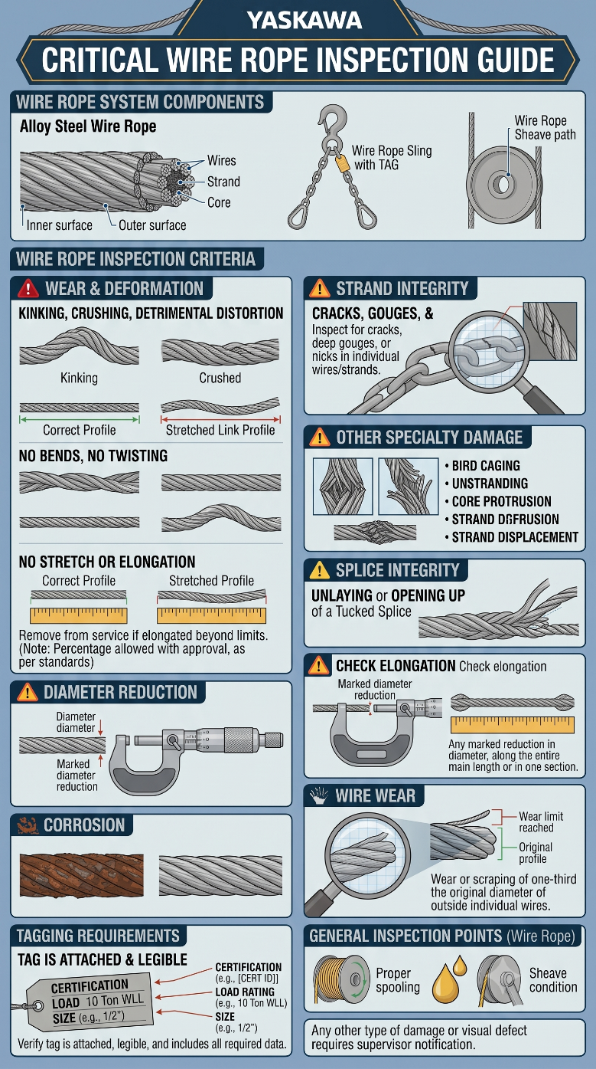
Daily Inspection
Wire Rope
Check the tag for certification and load rating
Kinking, crushing or other damage that results in detrimental distortion of the rope structure
Bird caging
Unstranding
Unlaying or opening up of a tucked splice
Strand displacement
Core protrusion from an opening between strands
Any marked reduction in diameter whether along the entire main length or in one section
Corrosion
Wear or scraping of one-third the original diameter of outside individual wires

Slide 16
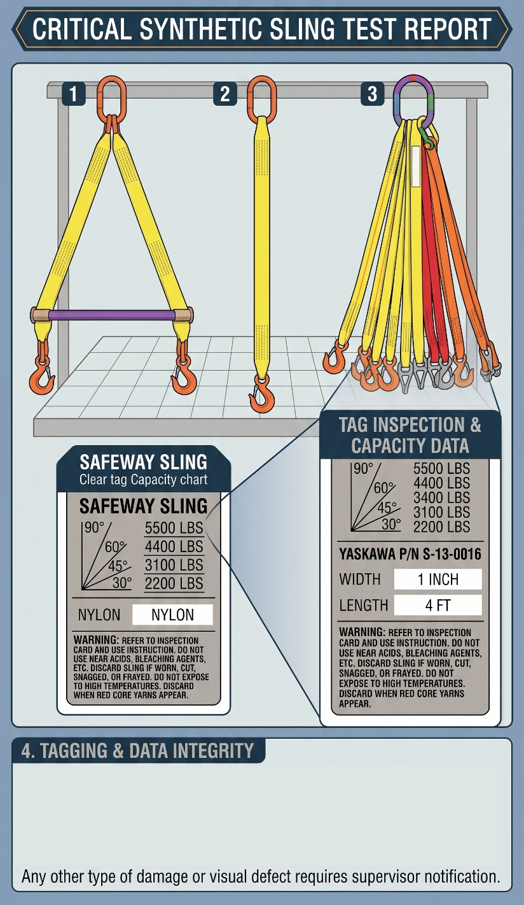
Daily Inspection
Inspect Synthetic Slings for the Following
Check the tag for certification and load rating
Acid or caustic burns
Melting or charring
Holes, cuts, punctures, crushed fabric
Tears, Snags
Broken stitches
Worn stitches
Excessive abrasion or wear on webbing or fittings
Knots
Discoloration
Anything that causes doubt to the continued use of the sling
Check for burns, melting or charring, holes, cuts, punctures, tears, snags
Check for broken or worn stitches
No knots

Slide 17
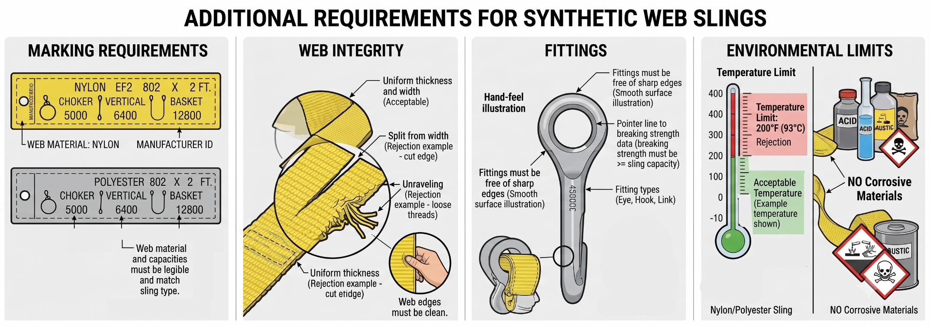
Daily Inspection
Additional requirements for synthetic web slings
Each sling must be clearly marked to show the rated capacities for each type of hitch, web material and manufacturer
Slings must contain web that is uniform thickness and width, and the edges must not be split from the webbing width and must not be unraveling
Fittings must be free of all sharp edges that could damage the webbing and must be of a minimum breaking strength equal to that of the sling
Nylon and polyester slings must not be used at temperatures above 200⁰ F or while handling corrosive materials

Slide 18
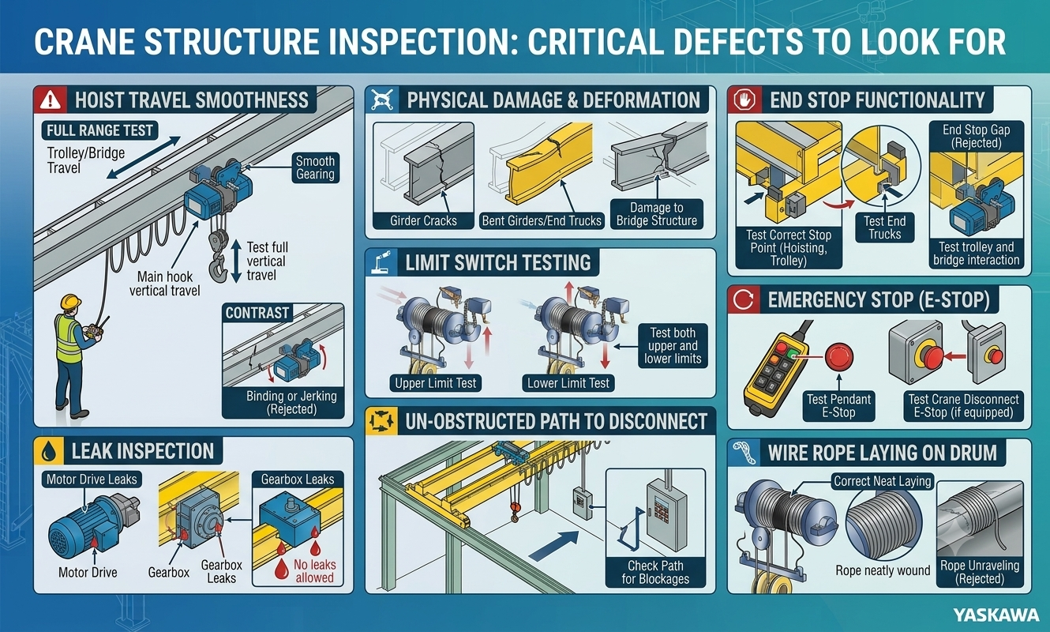
Daily Inspection

Slide 19
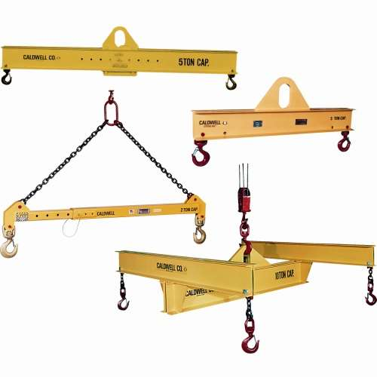
Daily Inspection
Special Rigging
Everything that supports the load must have a rating label
  Crane
  Hoist
  Slings
  Spreader Bars
  Hooks
  Shackles
  Any special rigging
Spreader Bar

Slide 20
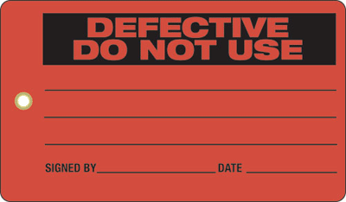
Daily Inspection
If any items fail inspection:
Attach a “Do Not Use” or “Defective” tag to the failed component
If the defective item is the crane or hoist:
  Lockout the power source
  Lockout must be completed by Lockout/Tagout qualified person
If the defective item is rigging:
  Remove tagged, defective item from area
  Give defective item to supervisor or manufacturing engineer

Slide 21
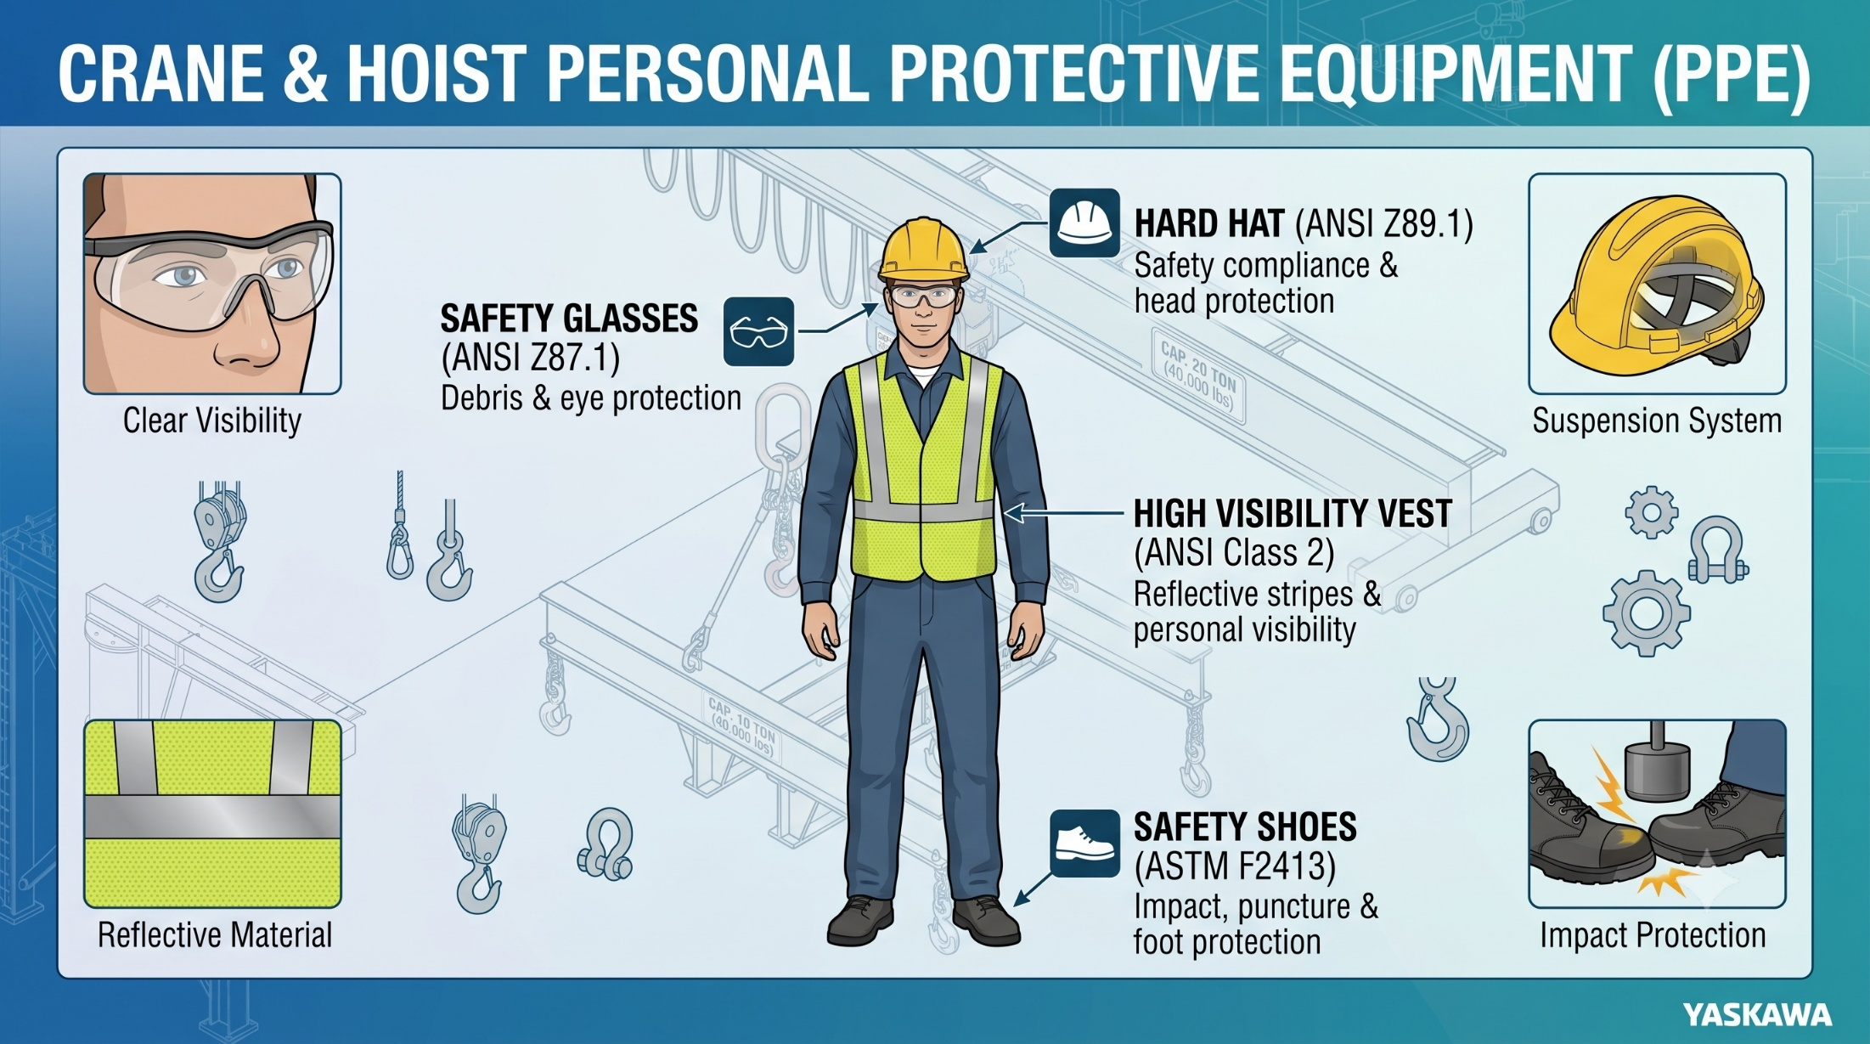

Slide 22
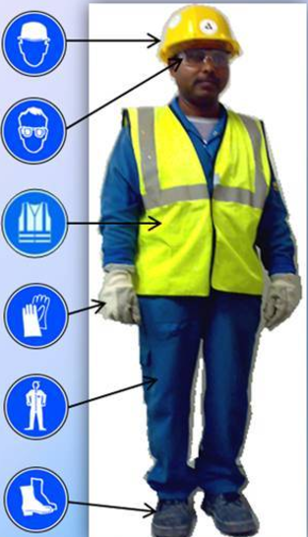
Personal Protective Equipment
Class C or Class G Hard Hat (ANSI Z89.1)
  Required for lifts where top of the load is chest high or higher
  Always required in FR1
Safety Glasses (ANSI Z87.1
  Required for all crane activities
Safety Vest (ANSI Class 2)
  Required for all personnel involved in lift during Critical Lifts
Leather Gloves
  Recommended when handling tag lines
Long Pants
  Denim is preferred
Safety Shoes with Toe Protection (ASTM F2413)
  Required for all crane activities

Slide 23
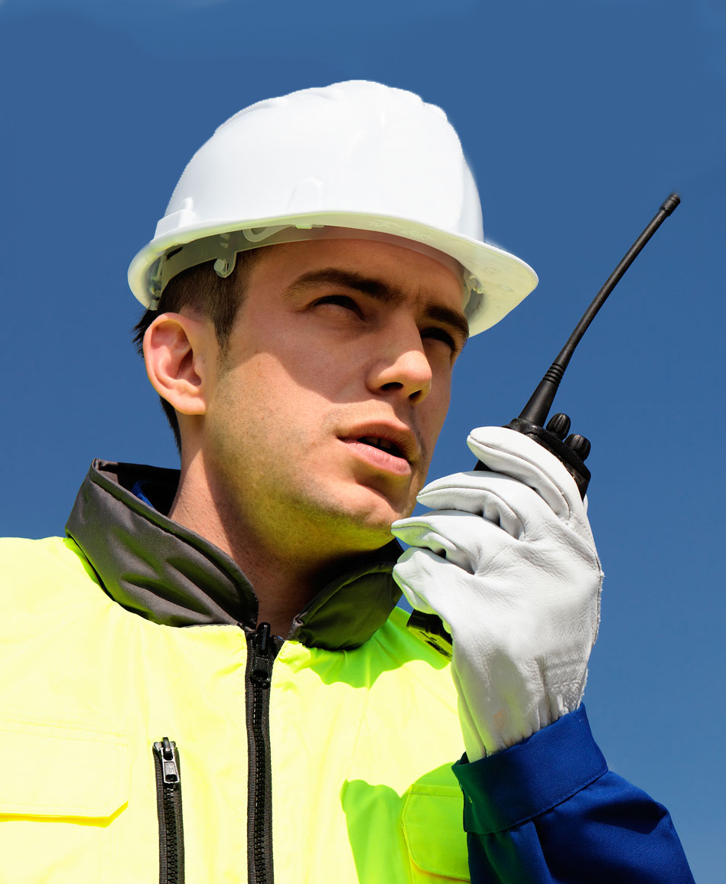
Communication
Whenever more than one person is involved in a lift, the method of communication must be planned.

Slide 24
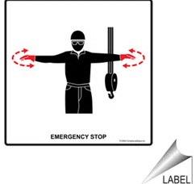
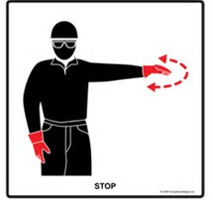

Communication
Crane operators must always obey Stop Signal regardless of who gives the signal.
Stop

Slide 25

Communication
Methods of Communication
Talking
  When all people are in view of each other, and
  You can easily hear each other without raising voices
Radio
  Verify radios work before lift begins
Hand Signals
  Review hand signals before the lift
Radio with Hand Signals

Slide 26
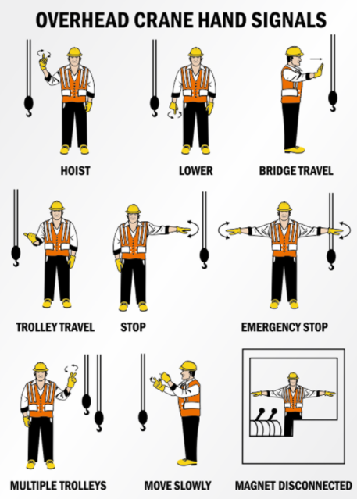
Communication

Slide 27
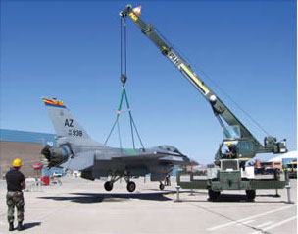
Rigging
Rigging

Slide 28
Rigging
Definitions
Rigging: The equipment for lifting and moving heavy loads with chains, slings, and mechanical devices.
Sling: A loop of material that connects the load to the lifting device. Slings can be made of chain, wire, metal mesh, natural, and synthetic materials.
Examples of Rigging Equipment
Slings
Hooks
Eyebolts
Shackles

Slide 29
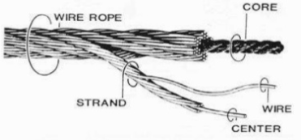
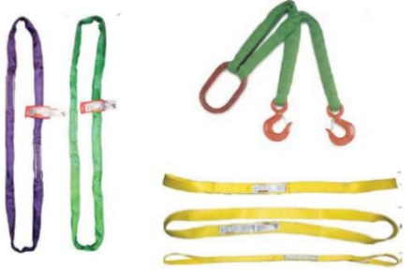
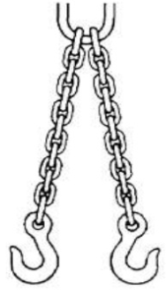
Rigging
Types of Sling Materials used in Yaskawa facilities
Wire Rope
Consists of a group of strands laid helically around a core
Synthetic Sling
Lighter weight that wire rope or slings
Good strength
Good shock absorption
Chain

Slide 30
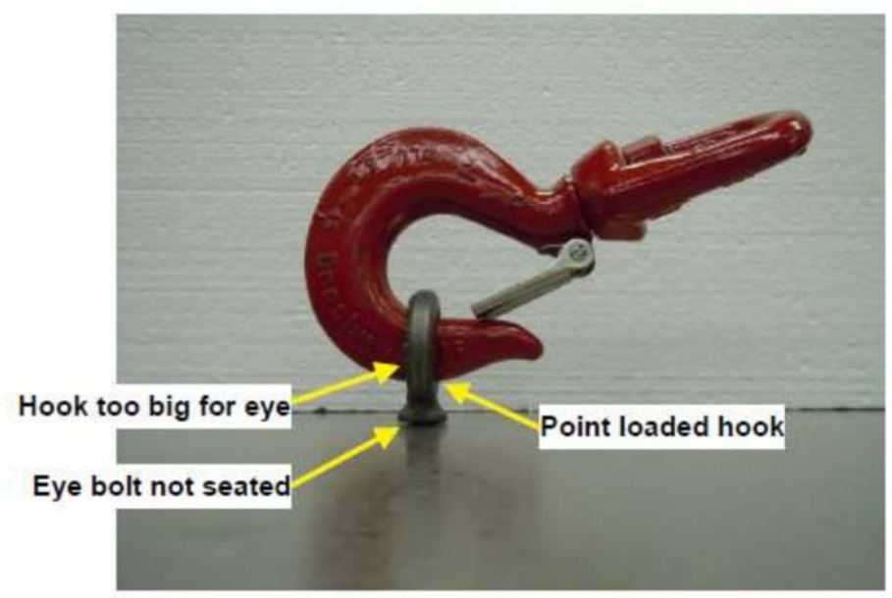
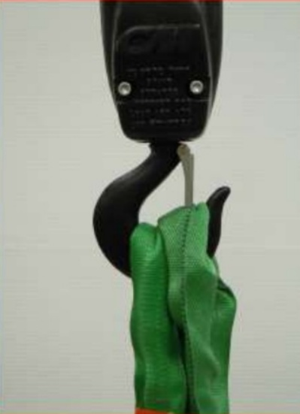
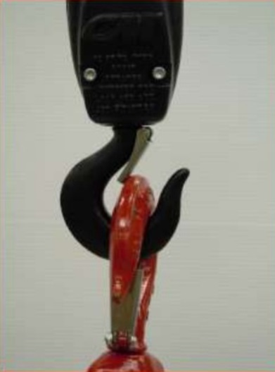
Rigging
Hooks
The most common method to connect the sling to the part.
The hoist hook must never be attached directly to the load. (Use slings)
The hook latch must fully close.
The hook must be large enough so the sling or eyebolt extends to the throat of the hook.

Slide 31
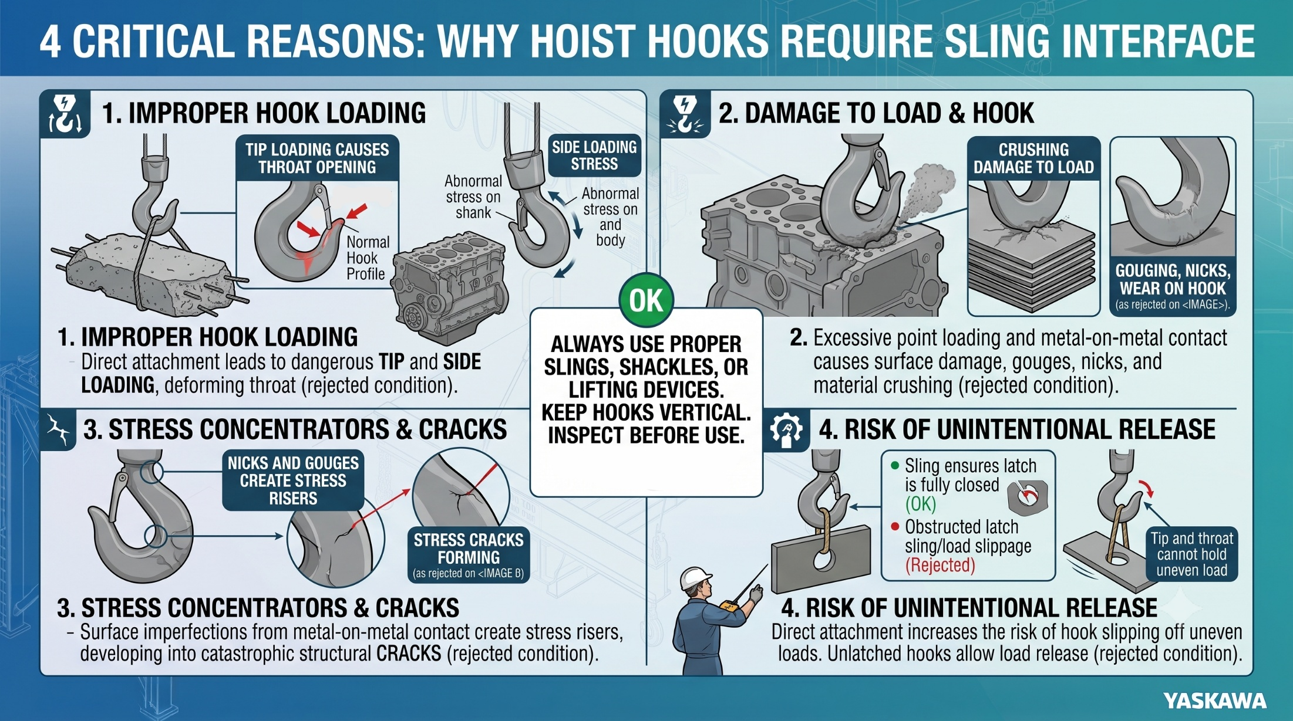
Rigging

Slide 32
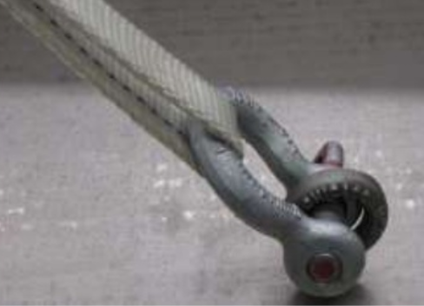
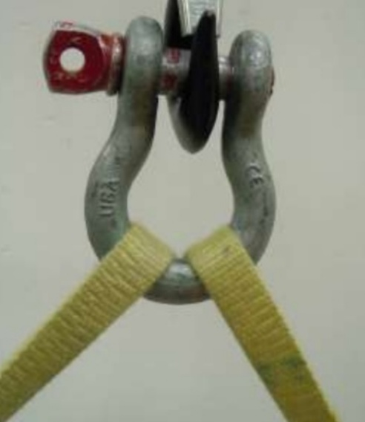
Rigging
Shackles
Commonly used to connect slings to the hoist hook.
Shackles must be large enough to support the slings.

Slide 33
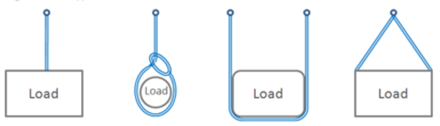
Rigging
Hitches
The method to attach the slings to the load is called the hitch.
There are four types of hitches:
Vertical Hitch
Choker Hitch
Basket Hitch
Bridle Hitch

Slide 34
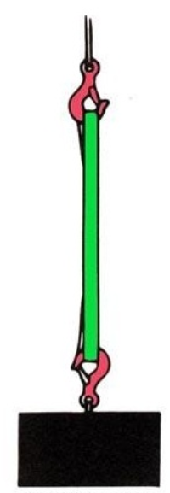
Rigging
Vertical Hitch
Remember: NEVER attach the hoist hook directly to the load.
Vertical hitches are used when lifting an object with one lifting point
Vertical hitches shall NEVER be used when lifting loose items, such as stacks of conduit

Slide 35
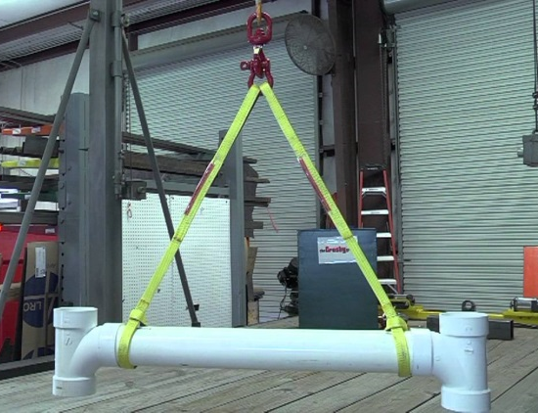
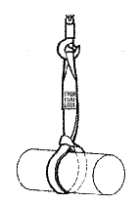
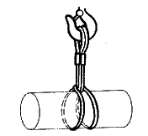
Rigging
Choker Hitch
With a choker hitch, the sling tightens on the load as it is lifted.
The sling passes through one end around the load, while the other end is placed on the hook.
A doubled choker hitch provides more contact to better secure the load.
Choker Hitch
Doubled Choker Hitch

Slide 36
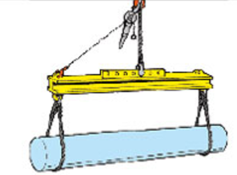
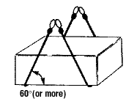
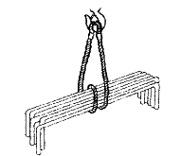
Rigging
Basket Hitch
With a basket hitch, the sling cradles the load while both eyes are attached overhead, generally to a spreader bar.
Double basket hitches balance the load by keeping the slings apart.
Prevent sling slippage by spreading the angle between the load and the sling to 60⁰ or more.
Double Basket Hitch
Doubled Wrapped Basket Hitch

Slide 37
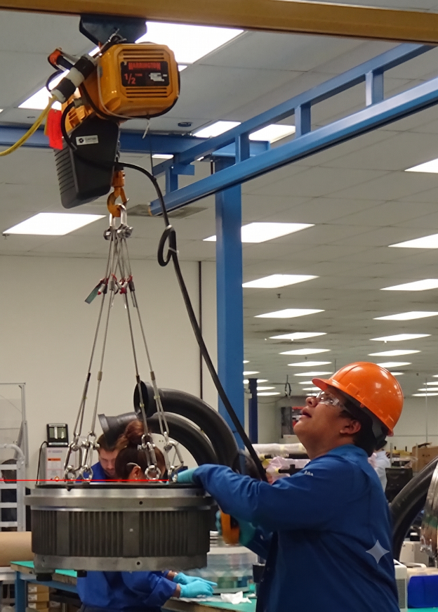
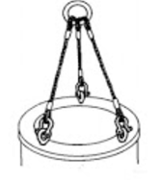
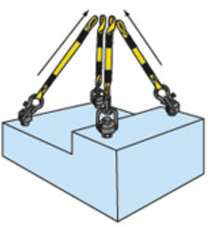
Rigging
Bridle Hitch
The majority of loads lifted in Yaskawa use a bridle hitch.
Bridle hitches are made of 2, 3, or 4 single leg hitches.
The hook must be centered over the center of gravity.
3-legged Bridle
4-legged Bridle

Slide 38
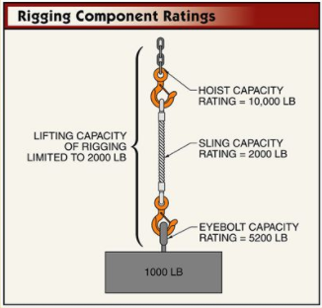
Rigging
The capacity rating of the weakest individual component (the weakest link) in a rigging arrangement determines the lifting capacity of the whole arrangement.
Any component that carries any portion of the weight of the load must have a capacity rating.
  Crane,
  Hoist,
  Slings,
  Hooks,
  Eye Bolts,
  Spreader Bars,
  Etc.
This rating is often defined as the Working Load Limit (WLL).

Slide 39

Rigging
WLL
Examples of Working Load Limits shown on rigging:

Slide 40

Rigging
Verify all rigging equipment is rated for more than the weight of the load.
HOWEVER,
Sometimes, the lifting capacity of the sling is less than what is shown on the label.
WHY?

Slide 41

Rigging
Imagine you are carrying two buckets of water at your side.
As long as your arms hang straight down, you can support the weight.
But, as you lift your arms, the amount of stress applied to your arms increases dramatically.
You would be unable to hold both buckets with your arms outstretched for very long.
The same is true of slings. As the sling angle decreases, the amount they can lift decreases.

Slide 42

Rigging
Most of the nylon slings used in Yaskawa show the ratings for the angle that will be used.
In the example on the left, the sling is rated to lift up to 1,700 pounds when the sling angle is 60⁰ or greater (90 ⁰ is when the sling is hanging straight down from the hook).
This sling cannot be used for any angle less than 60 ⁰.

Slide 43


Rigging
600
What is the capacity at:
90° __________
50° __________
40° __________
What is the capacity for a vertical lift at 90°?
___________

Slide 44

Rigging
To ensure the load is stable in the rigging, always make sure the center of gravity is:
Directly beneath the lifting hook, and
Below the place where the rigging is attached to the part

Slide 45

Rigging
Carrying a load with sharp edges can increase the stress on a sling leg.
Use edge protectors whenever the edges of the lifting point are sharp.

Slide 46

Crane Operation
Crane Operation

Slide 47

Crane Operation
Why we use cranes
Cranes are used to move objects that we cannot lift ourselves.
The human lifting limits within Yaskawa are:
  One person lift over 40lb
  Two person Lift over 60lb
  Parts Out side the Power Lift Zone
However, these limits assume a balanced load within the power zone (see green area), that can easily be carried.

Slide 48

Crane Operation
Types of Cranes in Yaskawa
Bridge
There are several types of cranes used in Yaskawa facilities.
Operators are qualified on each type of crane.
An operator can be qualified on one type of crane but not on another.
Gantry
Jib
A-Frame/Mobile
Other Specialty
Forklift under Forks

Slide 49



Crane Operation
Prior to lifting any load, you must know:
1. The lifting capacity of the crane,
2. The lifting capacity of the rigging,
3. The weight of the load.

Slide 50

Crane Operation
Do not overload the crane or hoist. Make sure the combined weight of the rigging and load does not exceed the rated load capacity of the crane or hoist.
Refuse to make lift if you are unsure of any issues.
Do not proceed until all issues are resolved.

Slide 51

Crane Operation

Slide 52


Crane Operation
NEVER SIDE LOAD
In normal operation, overhead crane hoists are designed to lift an object at a vertical angle.
A side load is when a portion of the hoist acts horizontally, such as when the hoist lifts an object that has not been placed directly underneath it.
Side Loading will:
Reduce the lifting capacity of the rigging,
Cause the load to swing, and
Damage the crane.

Slide 53


Crane Operation
Pick the load up slowly, with the hoist/hook directly above the load
Do not allow any side loading
Avoid sudden starts and stops to prevent shock loading
Do not allow any tangling or twisting of the rigging or hoist lines

Slide 54

Crane Operation
Before lifting, ensure that everyone is of any pinch or crush zones.
Ensure there is a clear path to safety.
When lifting the load, only lift it a few inches off the ground:
  To verify hoist brake is functioning properly, and
  To verify the load is secure and the load will not swing.

Slide 55

Crane Operation
Always maintain a clear view of the crane path so you can observe any obstacles or personnel in your path.

Slide 56

Crane Operation
Use one continuous motion when traveling.
Try not to start/stop (plug) as this will cause load swing.

Slide 57

Crane Operation

Slide 58

Crane Operation

Slide 59

Crane Operation
When the crane is not in use, always raise the crane hook above head level.

Slide 60

Planning the Lift
Equipment Limits
The lifting capacity of the crane operation is the smallest capacity of each of the components.
For instance, in the picture on the left, the smallest capacity is the hoist, at 1,000 lbs.
HOWEVER,
Sometimes, the lifting capacity is less than the rating shown on the label. For instance, slings have a higher rating when lifting vertically than when they lift at an angle.
This process is called de-rating.
Crane – 2 Ton
Hoist – 1,000 lbs
Straps – 2 Ton
Load – 500 lbs

Slide 61

Planning the Lift
Sling Angle De-Rating
Refer to the sling manufacturer for sling angle de-rating. The diagram shown on the left, and included on the back cover of the Crane and Hoist Pocket Guide, is a good general reference, but the manufacturer’s requirements takes precedence.

Slide 62
Planning the Lift
Fall Zone:
  Area that a load could fall on operator. As a general rule that is two times the hook height.
Restricted Zone:
  Area that is block off for a lift. Only Team members part of the lift should be in this area with proper PPE.
Landing Zone:
  Location that the load will be paced on or in. Should be clean and prepped before the lift start. (Cribbing, Stand, Skids, Cart, … ECT)
Path:
  The way that the load is going to take from it’s starting point to the Landing Zone. Should be clean and planned before lift.
Work Zone:
  Is the path, Landing Zone, Assembly Area.
Restricted Zone
Fall Zone
Work Zone
Landing
Zone

Slide 63


Planning the Lift
Define Working Area
Fall Zone
  Min fall zone two times the hook height
  Fall Zone can increase because of other factors
    Width of Load
    Other Items that might Fall
Restricted Zone (Landing Zone & Path)
  Only Team members part of the lift should be in the Zone.
  Proper PPE
Landing Zone
  Area should be clear
  Area should be prepped before the lift start. (Cribbing, Stand, Skids, Cart, Tools, … ECT)
Path
  See Fall Zone
Escape Path
  Each Operator should have an exit path out of the Restricted Zone.
  This path should be clear or hazards
Load
Load Path
Landing Zone
Fall Zone
Hook
Height

Slide 64
Planning the Lift
Standard vs. Critical Lifts
Standard Lift
A standard lift is one that:
Has previously been done under the supervision of a lift supervisor,
Has a defined process, and
Does not meet any of the criteria of a critical lift.
Critical Lift
A critical lift is one that:
Has an additional risk to Safety or production, including
  2 Cranes or more lifting on load
  Lifting of personnel (not allowed in Yaskawa Facilities)
  Any lift where the gross load exceeds 80% of the crane capacity
  Any lift where the gross load exceeds 80% of the working load limit (WLL)
  Any lift deemed to be unique, difficult, hazardous, results in restricted space
  Any lift of irreplaceable items or is critical to production or scheduling
  Any lift where critical lift process is deemed necessary by management

Slide 65
Planning the Lift
Critical Lift Process
If you identify a lift that meets any of the critical lift requirements, or where you believe the lift has an additional risk to safety or production:
Notify Supervisor
Supervisor notifies Lift Supervisor
Lift Supervisor reviews the lift and completes Critical Lift Plan

Slide 66

Crane Operation
Before operating the crane, you have:
Inspected the crane, hoist, and rigging (or verified the inspections have been completed),
Determined the weight of the load, and the working load limits of all of the equipment involved in the lift,
Defined your working area,
Determined and verified communication methods,
Donned all required PPE, and
Determined if this is a standard or critical lift.
  If critical lift, the lift supervisor has completed the critical lift plan and reviewed the plan with all associates involved in the lift.

Slide 67

Crane Operation
Secure rigging to the load.
Attach tag line if necessary.
Verify all associates not involved with the lift are outside of the restricted zone.
Verify all associates involved with the lift are:
  Clear of the fall zone
  Have unobstructed access to safe area outside of the restricted area
  Have unobstructed access to crane/hoist disconnect
Slowly lift the load to take up any slack in the rigging.
Slowly lift the load about 2-4 inches to ensure load is properly balanced, stable, and secured.
Slowly and evenly lift load to lowest height necessary to clear obstructions.
Slowly and evenly move the load.
When over landing zone, allow load to stop any swinging.
Slowly and evenly lower the load.

Slide 68

Accident Response
Before Accident
  Have an escape route
  Although you have taken all precautions, expect something to fail
During Accident
  Get out of the way
    No product, no matter how expensive, is worth the risk of serious injury or death
After Accident
  Secure the scene.
    Take actions to prevent any further damage
    Notify supervisor to initiate investigation

Slide 69
Review
When operating an overhead industrial crane, remember these key points:
Understand the type of crane, rigging, and controls you will be using,
Always perform inspections of the crane, the rigging, and the work area,
Know the load capacity of the crane, hoist, and rigging
Do Not overload the equipment
Use safe procedures when lifting, moving, and setting down loads,
Always wear required personal protective equipment.
You now must pass a quiz to test your understanding.
You must pass this quiz with 100% accuracy before proceeding to the hands-on training.

Slide 70
Hands-On Training
During your hands-on training, your instructor will show you:
How to inspect the crane, hoist, and rigging
How to determine the restricted zone, fall zone, and landing zone
How to properly remove power to the crane/hoist
How to properly select the rigging
How to properly attach the rigging
How to properly attach the rigging to the load
How to properly lift, travel with, and lower the load
Then, you will perform all of the steps shown above. Repeat your practice as many times as you need to fully understand each step.
When you are confident you have the skill necessary to safely operate a crane, tell your trainer that you are ready for the hands-on test. You must pass the test with 100% accuracy to become a qualified crane operator.

Slide 71
Hands-on Test
The following skill checks will be evaluated during the hands-on test:
Component Identification
  You will be asked to identify the main parts of the crane and hoist
  You will be asked to identify various rigging components
Pre-Operational Inspection
  You will be asked to perform the daily crane inspection
  You will be asked to identify what to look for while performing the inspection
Lift Preparation
  You will determine the fall zone and restricted zone
  You will be asked to describe your lift plan
  You will be asked how you will communicate during the lift
Task 1 – Perform the lift
  Select the proper rigging
  Properly attach the load keeping center of gravity directly beneath the lifting hook
  Lift the load to a safe height
  Move the load to the landing zone
  Lower the load
  Secure the equipment
Task 2 - Communication
  You will be teamed up with at least one other person
  You will determine your communication method
  You will be giving and receiving hand signals. You must respond correctly to the signal
Task 3 – Emergency Action
  During the lift, your trainer will describe a scenario
  Take the correct emergency action based on the scenario

