Slide 1

Crane & Hoist
Operator Training

Slide 2
Trainer Qualifications
Trainer Qualifications
Certification: Successful completion of Yaskawa’s Crane and Hoist Train-the-Trainer course.
Workplace Experience: A minimum of one year of documented experience as a qualified operator at Yaskawa America, Inc.
Classification Mastery: Qualified experience must explicitly align with the specific weight classification of the crane being instructed:
  Class I: < 5 Tons
  Class II: 5 to 9 Tons
  Class III: > 9 Tons

Slide 3
Preparation
Training is required when:
Initial Training
Complete before associate is assigned to a station with a crane
On-the-job training must be completed and competence evaluated before unsupervised crane operation
Complete before associate is assigned to a station with a crane
On-the-job training must be completed and competence evaluated before unsupervised crane operation
Refresher Training
Annual evaluation, and
After any incident, near-miss, or observation of unsafe operation

Slide 4
Preparation
Preparation
Initial Training
Schedule conference room and send invitations
Print copies of SAF-T-1001 for students, a training sign-in form, and certificates (all included in instructor binder)
Refresher Training
Annual evaluations should be included in the associate’s annual performance review in UKG. If this is not practical, the associate’s supervisor shall maintain copies of the annual evaluation.
If result of incident, near-miss, observation of unsafe behavior:
Review incident report
Tailor training around root cause
The associate’s supervisor shall maintain a record of the retraining.

Slide 5
Preparation
Hands-On
Initial Training
At Franklin
Discuss with Production Manager to determine which crane is available for training
At Buffalo Grove
Discuss with Production Manager to determine which crane is available for training
At All Facilities
All students must participate in hands-on training
Tour the facility to see all cranes and lifting devices
Refresher Training
Show the student how to properly inspect and operate crane and rigging
Discuss what the associate did incorrectly
Have the student show you safe operation
Student must be able to explain, in his/her own words, what he/she did wrong and how they will prevent repeating the mistake

Slide 6
Preparation
Testing
Initial Training
All students must pass the quiz with 100% accuracy
All students must successfully pass hands-on test
DO NOT BE AFRAID TO DISQUALIFY AN ASSOCIATE WHO FAILS ANY PART OF THE TESTING
Refresher Training
Re-certification must include a review of the associate performing a lift as part of their job
Associate completes quiz included in refresher training presentation
DO NOT BE AFRAID TO DISQUALIFY AN ASSOCIATE WHO FAILS RECERTIFICATION

Slide 7
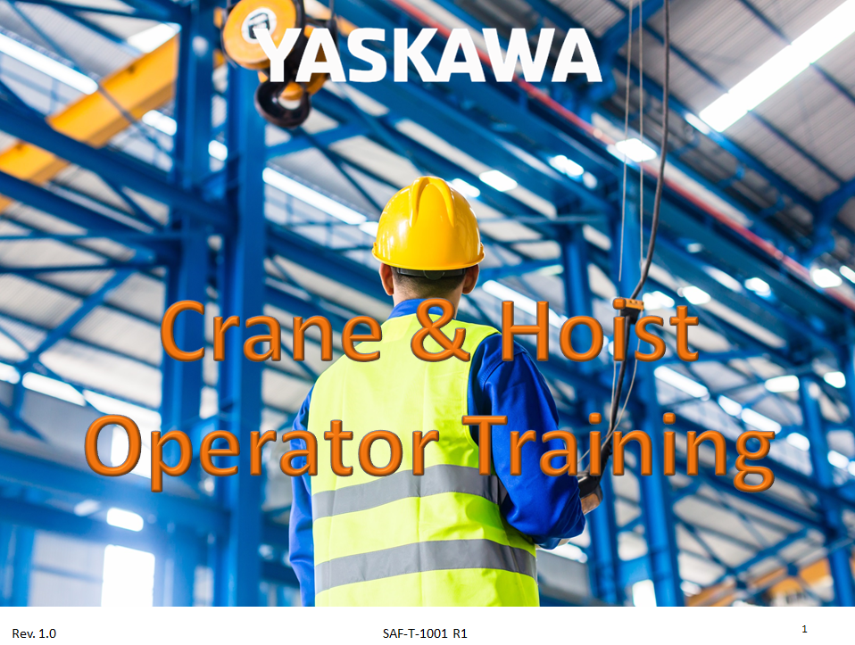
Classroom Training
Presentation
Open SAF-T-1001, located at:
G:\Safety\Safety Training\Crane and Hoist
Provide associate(s) with handouts.

Slide 8
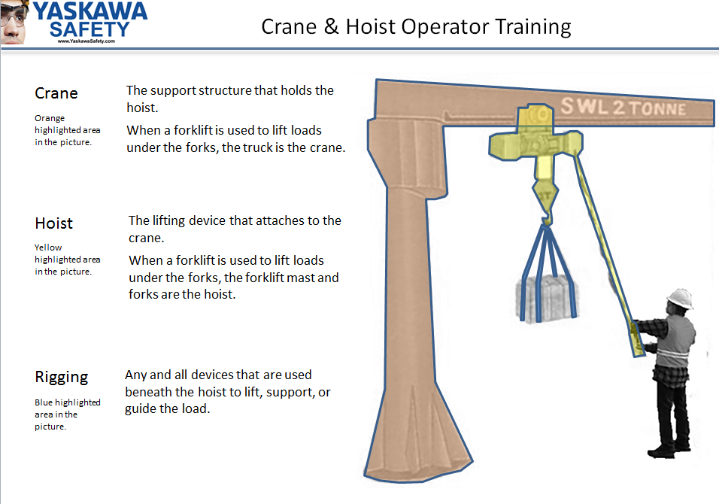
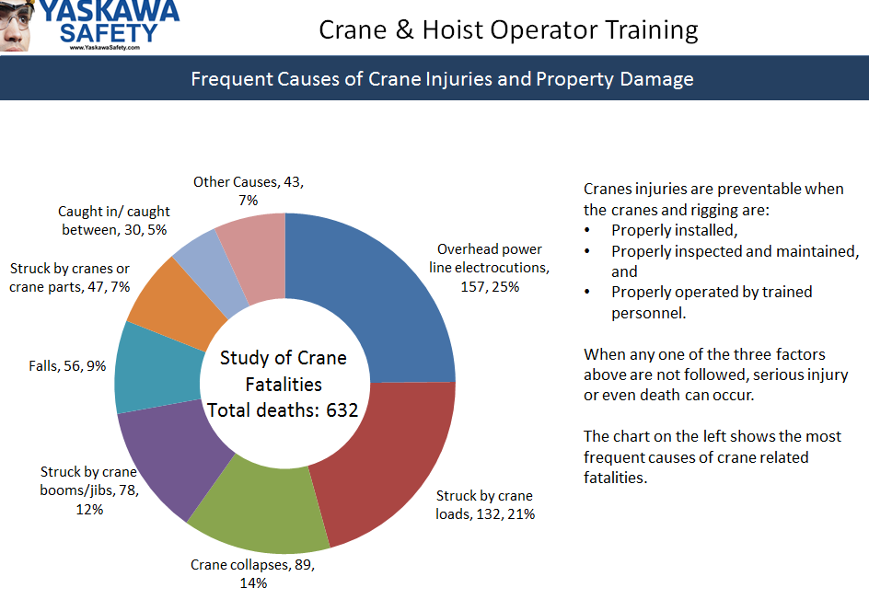
Classroom Training
Slide 2
Slide 3
Review the main parts of the crane with the operator(s) in training.
Discuss the common types of injuries and property damage that can occur when operating cranes.
Emphasize that crane accidents are 100% preventable.

Slide 9
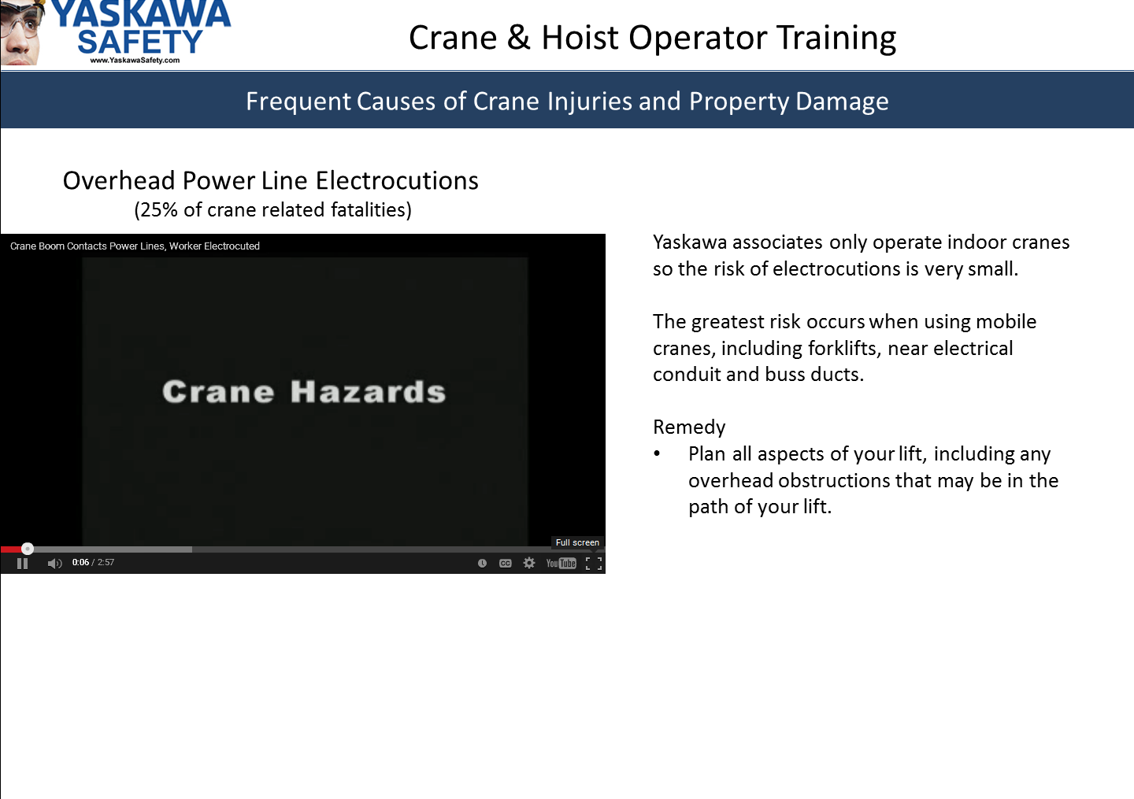
Classroom Training
Slides 4-8
The next several slides include YouTube videos.
You can view the video in full screen by hovering the mouse over the bottom section of the screen, then click on the Full Screen icon on the bottom right.
These videos are studies of actual events that led to fatalities while using cranes in shipyards. Discuss how the cranes used within Yaskawa pose similar hazards.
Each of these videos contain two parts: first a description of the accident, then what mistakes were made that led to the accident.
Pause the video before the second part and ask the operator-in-training to tell you what caused the accident, then show the rest of the video.

Slide 10
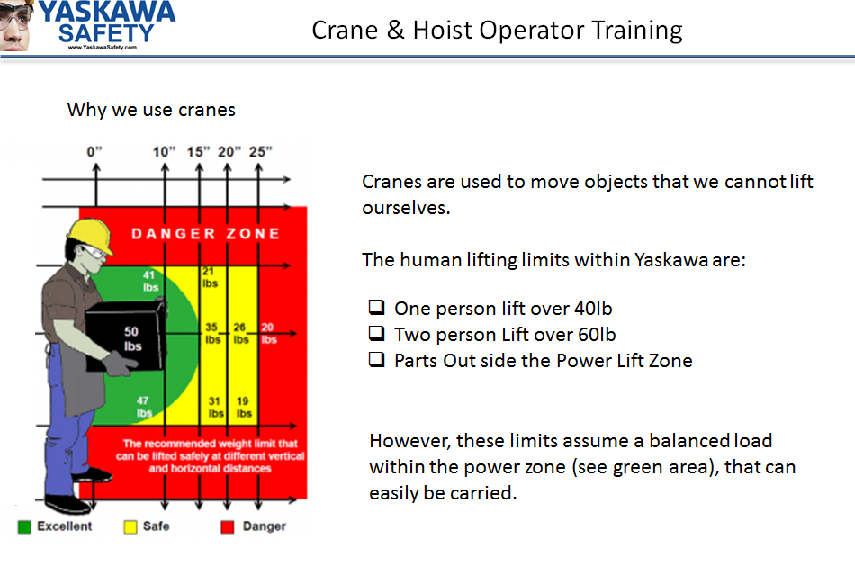
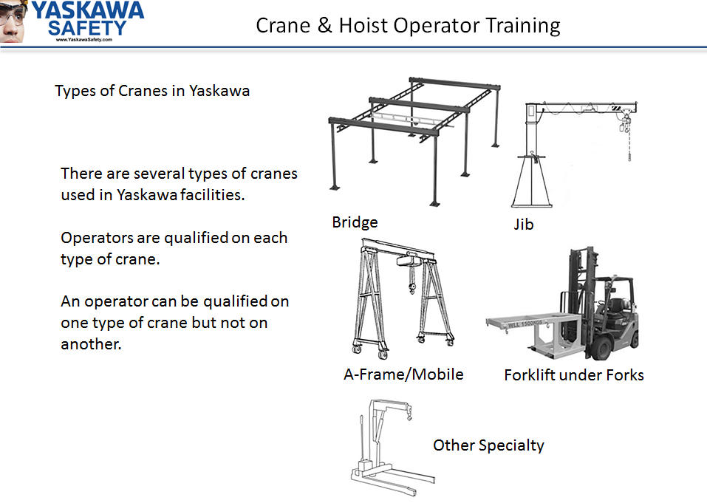
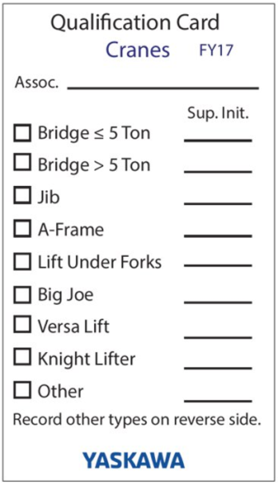
Classroom Training
Slide 10
Slide 9
Review the types of cranes.
Emphasize that this presentation is general education on cranes, hoists, and rigging. They will receive hands-on training to become skilled at operating the specific types of cranes they will operate.
Each type of crane requires its own qualification. The trainer or supervisor will fill out a Qualification Card. (more on this later)
Discuss why we use cranes.
It is important for associates to understand that we sometimes need a crane even when parts weigh less than 40 lbs.
Ask students why we might use a crane when an object is less than the human lifting limits. Examples are:
Outside of the power zone
Awkward to carry part
Unbalanced load
Frequent lifting (no one wants to lift 40 lbs 300 times in a day)

Slide 11
Classroom Training
At the completion of the video, ask the students to complete the questions on the following slides.
You can do this one at a time or have them complete all of the questions then review the answers with them.
You may do this as a group activity, if you want. Just make sure they have and understand the correct answers before proceeding.
The following slides include the questions and answers.

Slide 12
Classroom Training
What are the three things that must be verified before operating a crane?
_Crane and rigging must have been inspected____________________
_The crane and rigging must have enough capacity to lift the load___
__The load and rigging must be stable__________________________
Slide 12
What is the most important factor when lifting?
Slide 13
To make sure you don’t lift more than the crane and rigging can
handle_________________________________________________
Slide 14
Before lifting any load, you should know:
__The load capacity of the crane______________________________
_The load capacity of the rigging______________________________
_The weight of the load_____________________________________

Slide 13
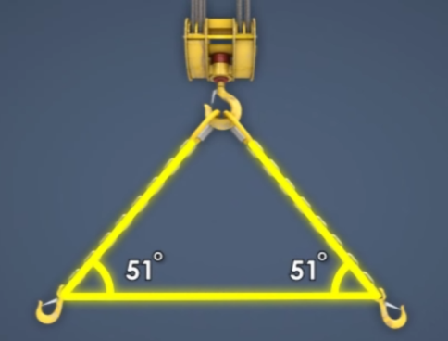
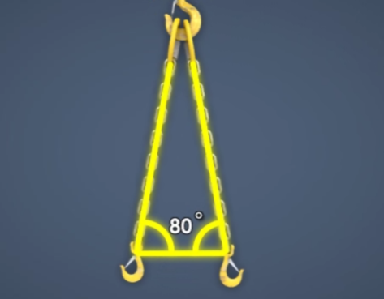
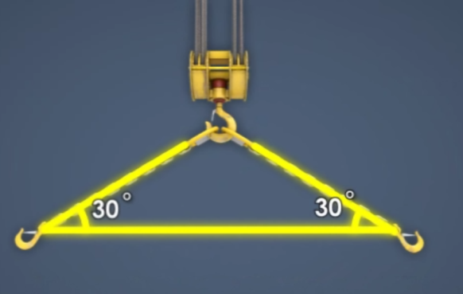
Classroom Training
What is the most important factor when using a sling?
Slide 15
___The sling angle_____________________________________________
Why?
___The smaller the sling angle gets, the smaller the slings load capacity
gets._____________________________________________________
Slide 16
Rank the sling angles below from strongest (1) to weakest (3).
2
1
3

Slide 14
Classroom Training
A good crane operator always: (Check all that apply)
Errs on the side of caution
Never puts anyone in harms way
Gets the job done as quickly as possible
Is always aware of the area of operation before starting operation
Is aware of nearby people and ensures they are not too close
Slide 17
When working near people, never:
Slide 18
_________________________________________________________
_________________________________________________________
_________________________________________________________
_________________________________________________________
Move a load over a person
Allow a person to ride on a load
Allow a person to get into a pinch point between a load and
Other objects

Slide 15
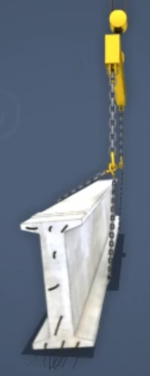
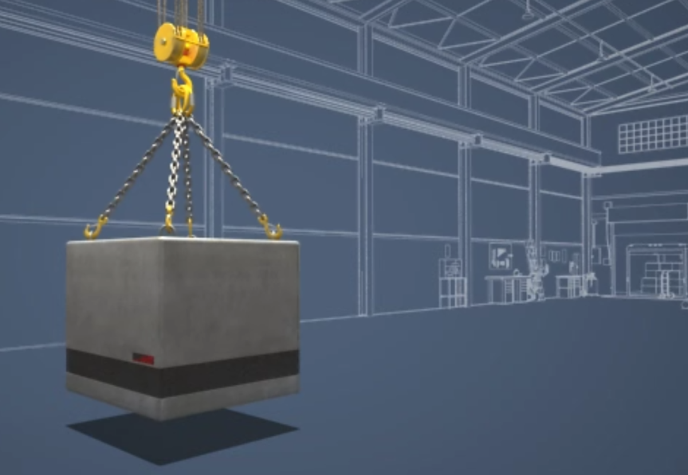
Classroom Training
side loading
Moving a load from the side is called ______________________
and should __________________ be done.
Slide 19
never
Slide 20
Loads should be moved with
___________, ________________
movements.
slow
smooth

Slide 16
Classroom Training
When traveling with the load: (Check all that apply)
Travel with the load as low to the ground as possible
Travel with the load as close to the hoist as possible
Make sure slings don’t get tangled or twisted
When walking with the load move it by pushing at the bottom of the load
When walking with the load, walk beside the load and use a tag line
Slide 21
Slide 22
When lowering the load, do not: (Check all that apply)
Leave the load suspended for long periods of time
Make sure load is stable and stops swinging
Lower the load slowly and smoothly
Land the load fully
Leave the load suspended while unattended

Slide 17
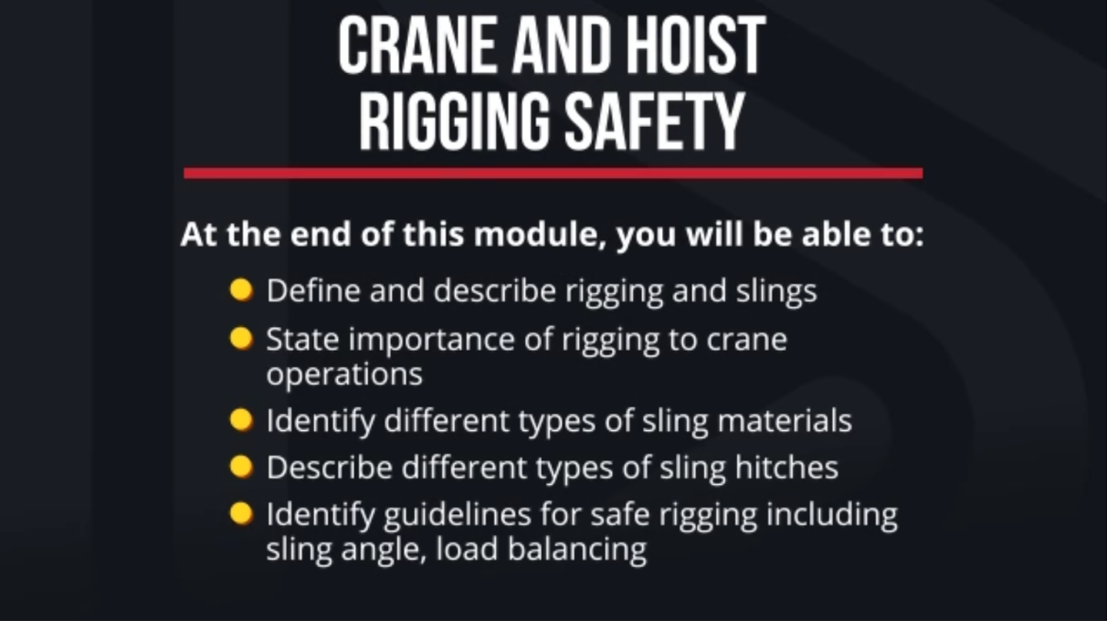
Classroom Training
Slide 23
At this point, show the Crane and Hoist Rigging Safety video that is on the USB.
There will be questions after the training. Do not allow students to complete the questions during the video because they may lose valuable information while trying to fill in the answers.
The questions are not part of the graded quiz.

Slide 18
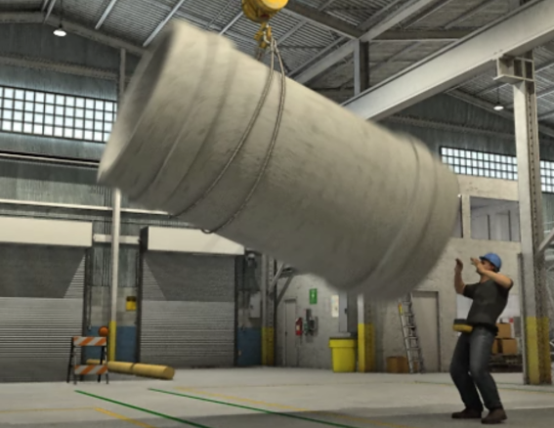
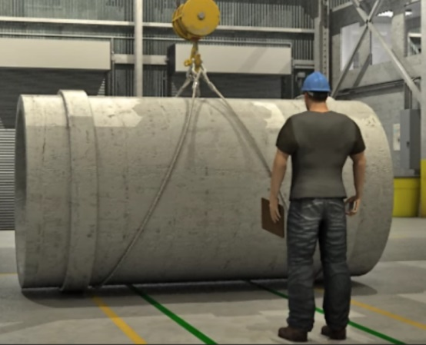
Classroom Training
Unsafe rigging can cause unstable or falling loads which can lead to
_____________________________________ or
_________________________________________.
Slide 24
Injury
Property Damage
A properly rigged load is: (Select all that apply)
Slide 25
Well within the equipments load capacity
Stable and Secure
Presents minimal danger to equipment or personnel
Side loaded

Slide 19
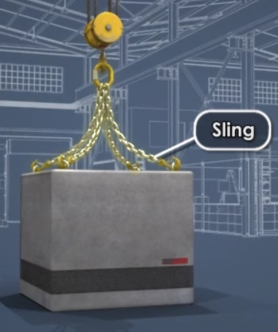
Classroom Training
Safe rigging depends on these primary factors: (Select all that apply)
The type of sling
The type of hitch
The sling angle
The load edge sharpness
The load capacity
The load stability
Slide 26
What are the three functions of the sling?
Slide 27
Support the load
Spread out the load weight
Absorb shock of quick stops
Make the load more stable and balanced

Slide 20
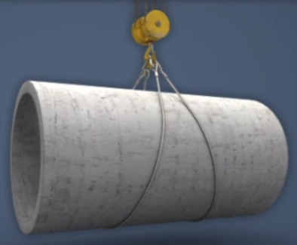
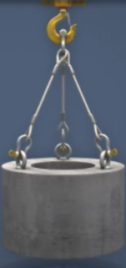
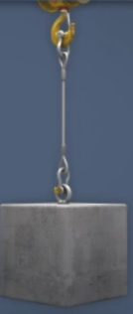
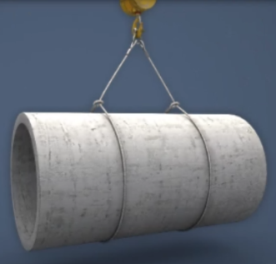
Classroom Training
_____________________ slings should not be used when lifting high temperature loads or loads with corrosive substances.
Synthetic
Slide 28
Match the hitch type to the name
Slide 29
C
D
A
B
________ Vertical
________ Basket
________ Choker
________ Bridle
A
B
C
D

Slide 21
Classroom Training
A ______________________ hitch should not be used for lifting loose materials or loads that are difficult to balance.
Vertical
Slide 30
Center
Gravity
The ___________________________ of ___________________________
is the point around which an objects weight is evenly distributed.
To have a balanced load the ___________________________ of ________________________ must be directly below lifting hook.
Slide 31
Center
Gravity
Slide 32
The loads attachment points must be ( above / below ) the loads center of gravity.
(Circle correct response)

Slide 22
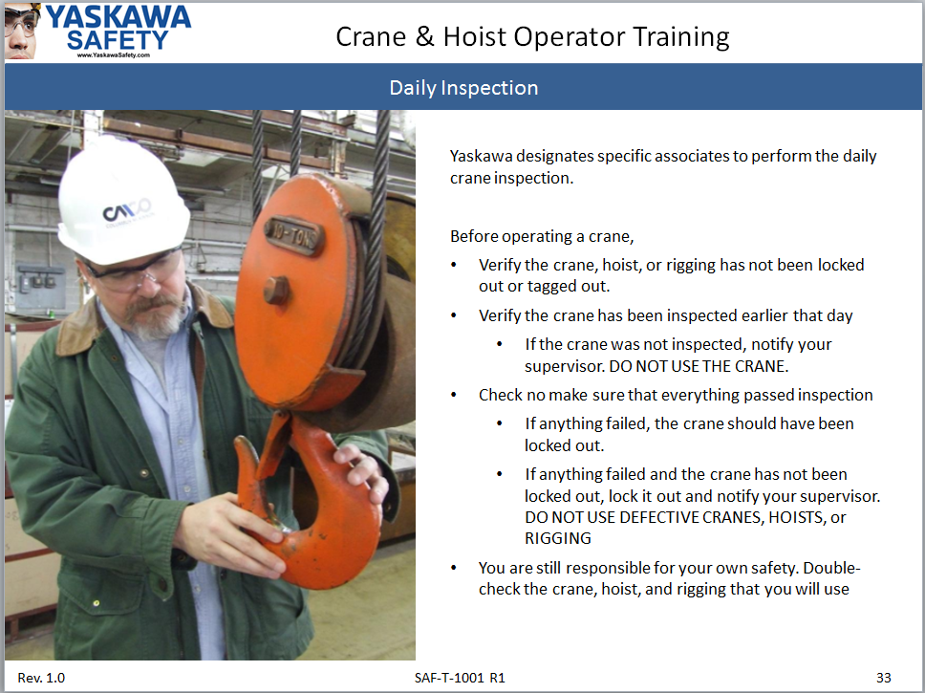
Classroom Training
Slides 33 - 45
These slides go through the inspection process.
Where possible, bring example rigging items to the class to show what you are looking for.
You will also review the inspection during the hands-on section of the training.

Slide 23
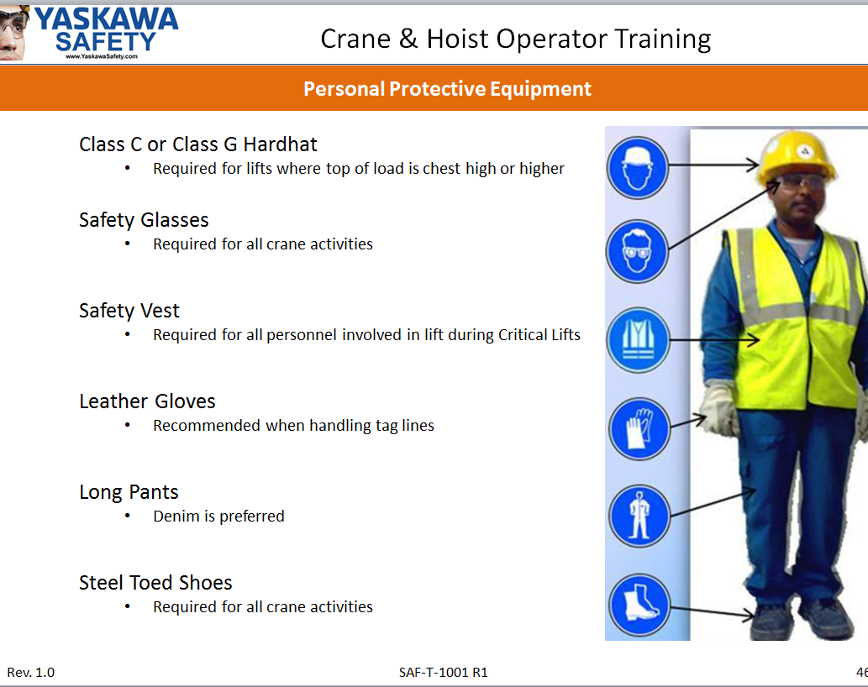
Classroom Training
Slides 46 - 50
Slide 46 addresses the PPE requirements.
Slides 47-50 address communication. Demonstrate the hand signals.
Emphasize that, during the lift planning, the crane operator must review the hand signals with all associates involved in the lift.

Slide 24
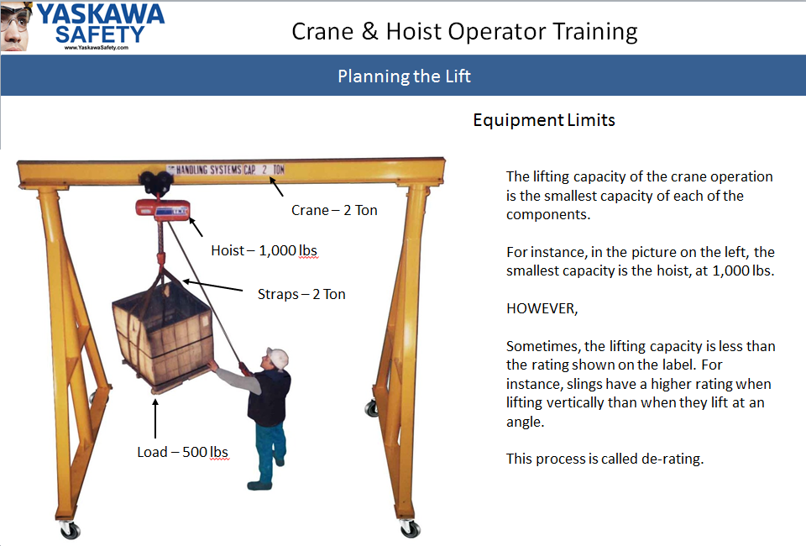
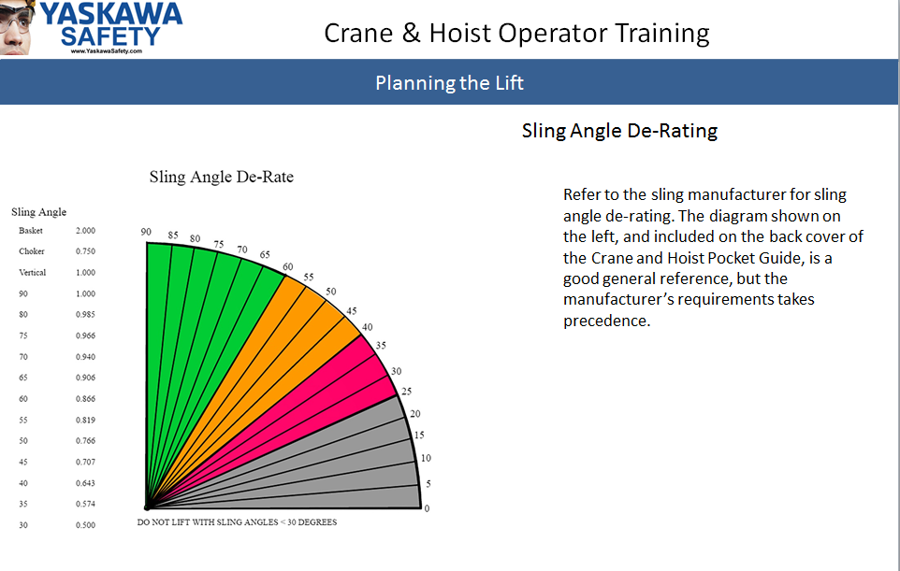
Classroom Training
Slide 51
Emphasize two points:
You must know the weight of the load , and
The lowest rated equipment defines the working load limit. (The weakest link defines the lifting capacity.)
Slide 52
Show examples of sling labels that show the WLL with various angles.
The equipment’s manufacturer defines the lift angle de-rate. The guide is a good reference but it does not over-ride the manufacturer’s requirements.

Slide 25
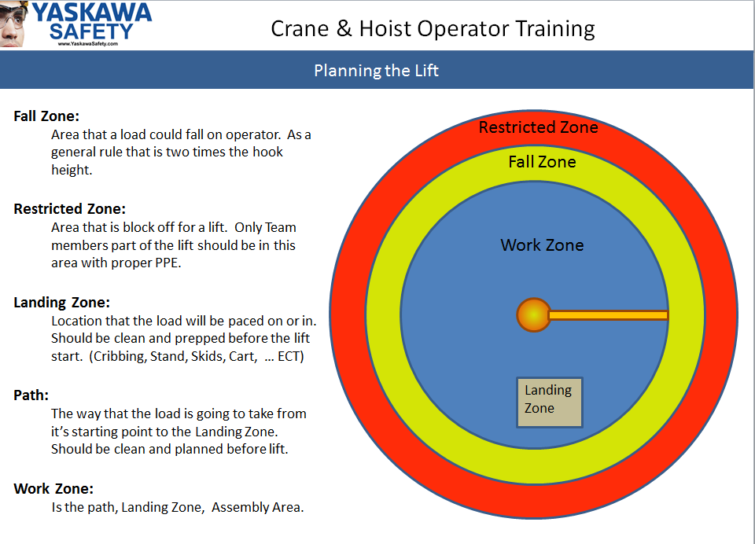
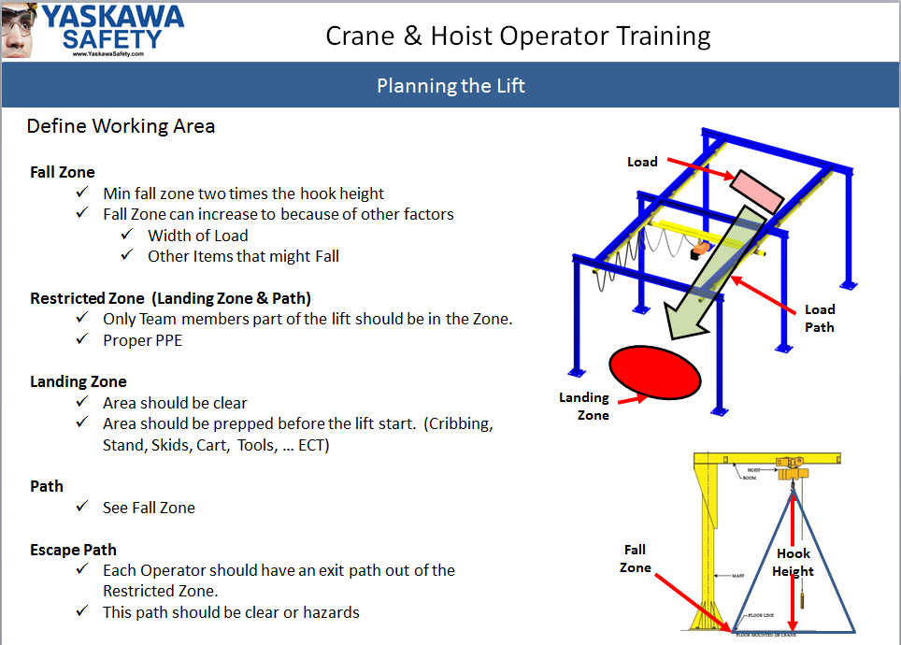
Classroom Training
Slide 53
The crane operator is in charge of the lift, and all personnel present within the restricted zone.
The restricted zone is determined by the crane operator. It must be beyond the fall zone.
Slide 54
The slide states that the fall zone includes “other items that might fall.” Ask the student(s) to say what other items might fall. Some examples are:
Anything a swinging load could strike
A part of the crane or rigging
A mobile crane can tip over

Slide 26
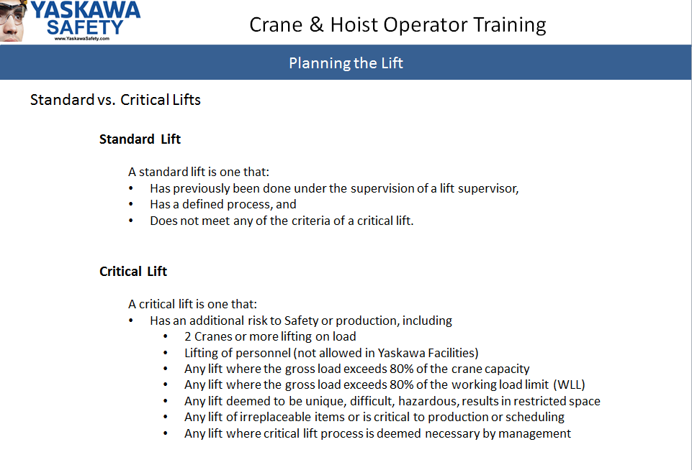
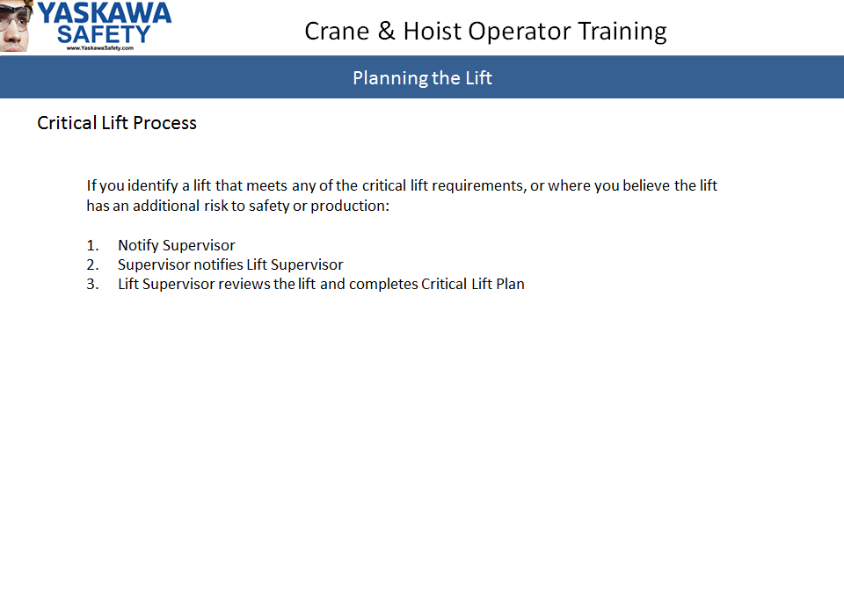
Classroom Training
Critical Lifts
Crane operators do not have to know how to develop the critical lift plan. That is the responsibility of lift supervisors.
However,
Crane operators must be able to determine if a lift is critical. Once they determine a lift is a critical lift, they must get a lift supervisor.

Slide 27
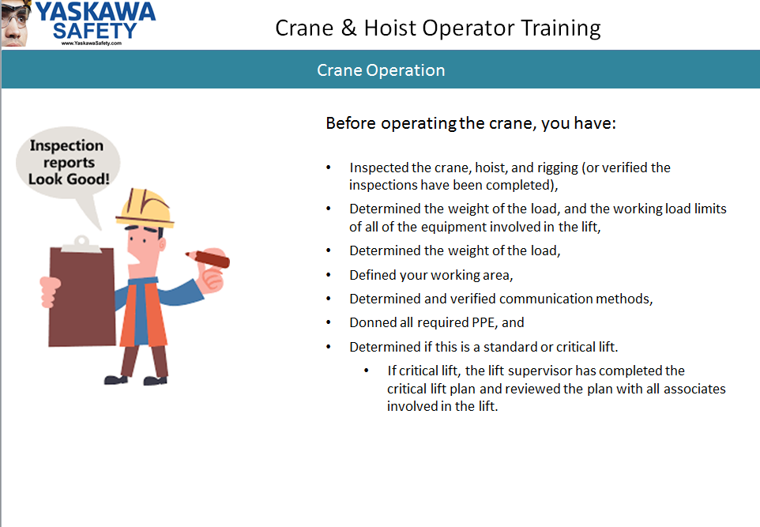
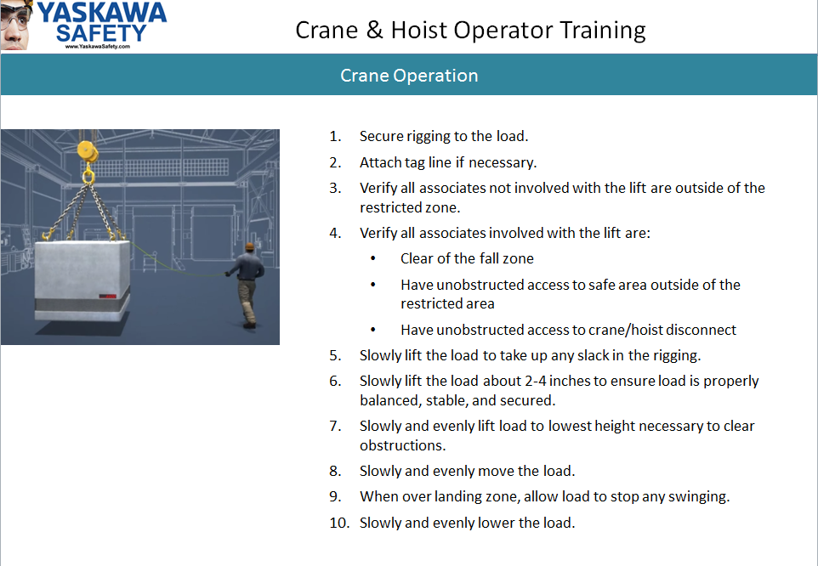
Classroom Training
Take note that gaining general knowledge of safe operation of cranes and planning the lift consumed 56 slides.
Performing the lift is covered in two slides.
Safe Crane Operation relies on proper planning!
Once the lift has been completed, rigging should be inspected and returned neatly to its storage location.
If the rigging has been stressed, used beyond its capacity, or shows any signs of defects, it must be marked with a defective tag and removed from service.

Slide 28
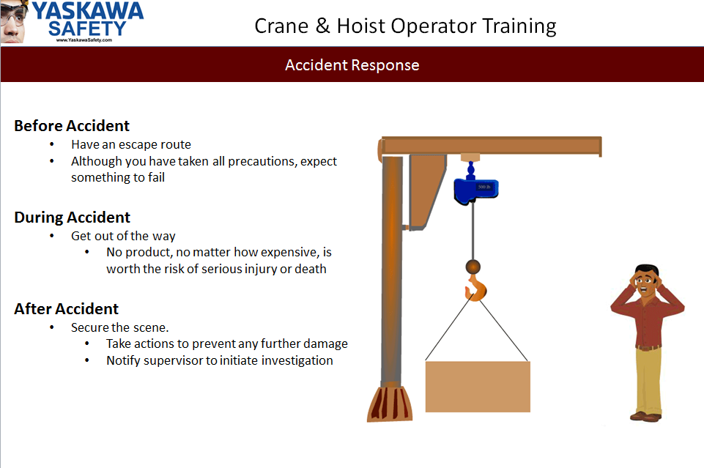
Classroom Training
Be prepared for something to go wrong.
If the equipment was properly inspected, the lift was properly planned, and the lift is performed slowly and smoothly, the lift should be safe. However, things can and do happen. You must be prepared.
If something does happen, protect yourself by following your escape plan. Resist any urge you may have to protect the product.

Slide 29
Classroom Training
Review
  Take as much time as necessary to review.
  Emphasize that the student must pass the test with 100% accuracy.
Test
  The test is included in your packet. When the test is revised, EHS will send you a new copy.
  When you receive the new test, destroy previous versions.
  You can check to see if you have the latest revision be opening the document “Crane and Hoist Document List” located on G:\Safety\Safety Training\Crane and Hoist\
  There are two reasons why a student may not pass the test on the first attempt:
    He/She does not understand the material presented, or
    He/She does not understand the question
  Talk with the student about any missed questions. Yaskawa has some associates who speak English very well but may not understand the question the way it was written. Without prompting or hinting at the answer, you may ask the question orally using different wording. If the student clearly understands the material, you may mark the question as pass.
  If the student does not understand the material, review the material with the associate. Then wait a minimum of three days before allowing the student to re-take the test.

Slide 30
Hands-on Training
NOTE: The initial qualification is valid only for jib cranes and bridge cranes ≤ 5 Tons. Additional hands-on training is required to become qualified to operate other types of cranes including:
Bridge cranes > 5 tons
A-Frames
Forktruck under the fork lifts
Big Joe
Knight Lifter
Air Lifter
Versa Lift

Slide 31
Hands-on Training
Facility Tour
  Walk through the entire facility and point out each crane, hoist, and type of rigging equipment. The students should be able to identify the type and state if they will be qualified to use the equipment upon successful completion.
Component Identification
  Show different types of rigging used in the facility.
  Show the WLL, tags, and labels.
  Show how to read rating labels
  Show location of crane disconnects
Pre-Operational Inspection
  Complete an inspection on at least one bridge crane and one jib crane
  Include inspection of multiple types of rigging in the area
  Show what to look for with each type of device
  Show how to complete the crane inspection form

Slide 32
Hands-on Training
Lift Preparation
  Before going to training area:
    Prepare a load that will be moved from a loading zone to a prepared landing zone
    Place something that will obstruct the travel between the loading zone and the landing zone
  With the Students:
    Identify the loading zone, the landing zone, the travel area, the fall zone, and the restricted zone
    Ask students what needs to be done before the lift. They should be able to state,:
      “complete the crane inspection” or “verify the inspection has been completed”,
      “clear the path” between the loading zone and landing zone
      Identify the location of the disconnect
      Identify the exit path
      Discuss the communication method

Slide 33
Hands-on Training
Performing the Lift
  Analyze the load, including the weight, center-of-gravity, and best hitching method
  Discuss the best type of rigging to be used for the lift
  Read the rating labels on all of the equipment (crane, hoist, rigging)
  Attach the rigging
  Discuss how the sling angle affects the working load limit. Determine if the straps need derating based on the sling angle of this lift.
  Lift the load. Ask students what height the load should be during the move
  Move the load to the landing zone slowly and smoothly
  Discuss when tagging lines should be used
  Wait for the load to stabilize (stop swinging) and slowly lower the load
  Remove rigging
  Perform post-lift inspection
  Replace rigging to storage location
Communication
  Discuss communication methods
  Review hand signals

Slide 34
Hands-on Training
Emergency Action
  Discuss emergencies that could occur during the lift
  Explain how they would respond to the emergency
  Stress that with emergencies are extremely rare when cranes and rigging are:
    Operated by qualified associates,
    Properly installed,
    Properly maintained,
    Properly inspected,
    Lifts are properly planned, and
    Lifts are performed with slow, smooth movements

Slide 35
Hands-on Training Test
NOTE: Hands-on Test shall not be completed on the same day as the hands-on training.
Preparation
  Place the load in the training area
  Place an obstruction between the loading and landing zones
  DO NOT place defective components in the area to test the associate. This could be used inadvertently. You may take a defective piece of equipment and ask the associate to inspect it, but make sure you keep it in you control at all times.
Follow all of the steps included on Test (SAF-F-1001)
If the associate Passes,
  Send copy of test (written and hands-on) to EHS@Yaskawa.com
  EHS will complete the certificate and qualification card
If the associate Fails and item,
  Review the step that the associate failed
  Schedule a new test
  If the associate fails the test three times, they will not be qualified.
    Send copies of all three tests to EHS@Yaskawa.com
    EHS will notify the associate’s supervisor
    EHS and the associate’s supervisor will determine if the associate should retake the entire course or if he/she will remain unqualified indefinitely.

Slide 36
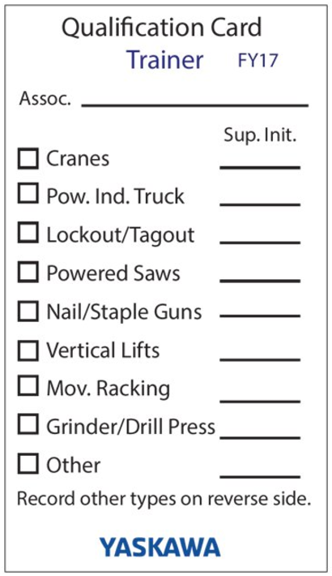
Post Qualification
Trainer Qualification
At the completion of this course you, as a trainer, will be observed training one or more associates.
You will be qualified as a Crane Trainer after successful completion of this evaluation.
You will be qualified to train associates to operate jib cranes and bridge cranes ≤ 5 tons.
Equipment specific hands-on training is required for other types of lifting equipment.

Slide 37

Post Qualification
Qualified Associate Qualification
When the associate has successfully passed the written and hands-on tests, send copies of the tests to EHS@Yaskawa.com.
EHS will:
Complete Certificate
Complete Qualification Card
Notify Supervisor
Enter into database
Notify supervisor 45-days before required annual assessment

